Slide 1


Choice Point Masterclass,
Part 4 of 4
Be the Change, Part 2
Harry Massey & Lenny Izzo

Slide 2
Choice Point
Be the Change

Slide 3
Reminder
Reality is a construct!
How you connect the dots creates your construct
Your construct is your freedom!
You have full control of your mind
You have full control of your next cycle in our Global Choice Point

Slide 4
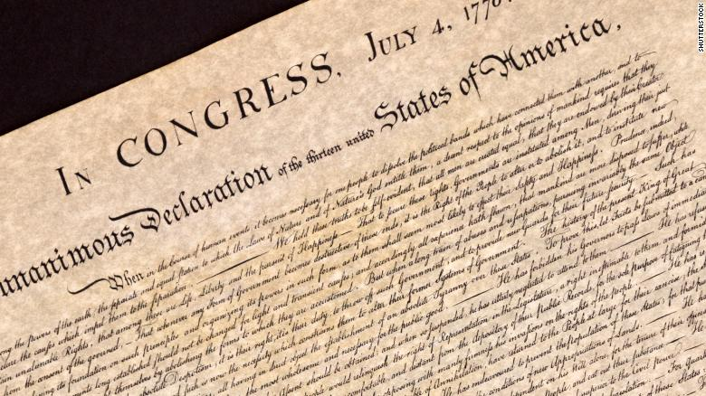
“We hold these truths to be self-evident, that all men are created equal, that they are endowed by their Creator with certain unalienable Rights, that among these are Life, Liberty and the pursuit of Happiness.”
- The Declaration of Independence
While Civil Liberties are under attack, the ultimate battle is in the mind.
Tyranny comes from Fear & Obedience
Your POWER comes from Freedom to Choose your purpose
The Avatar:
“Surrender with Illuminated Purpose to the Great Unfolding”

Slide 5
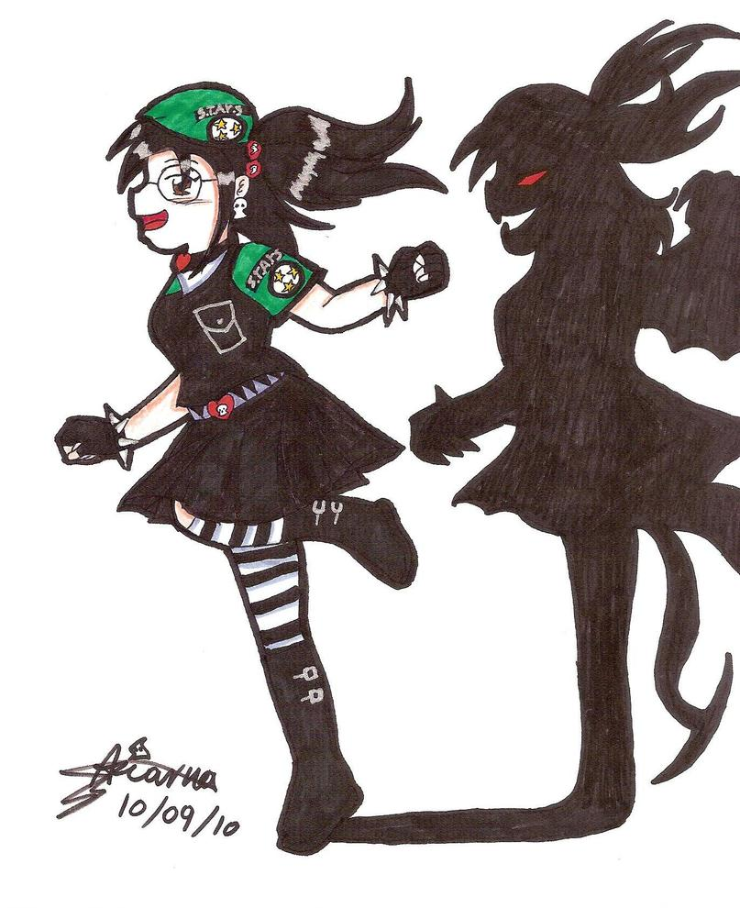
Archetypes & Your Shadows
(Dr. Lenny Izzo)

Slide 6
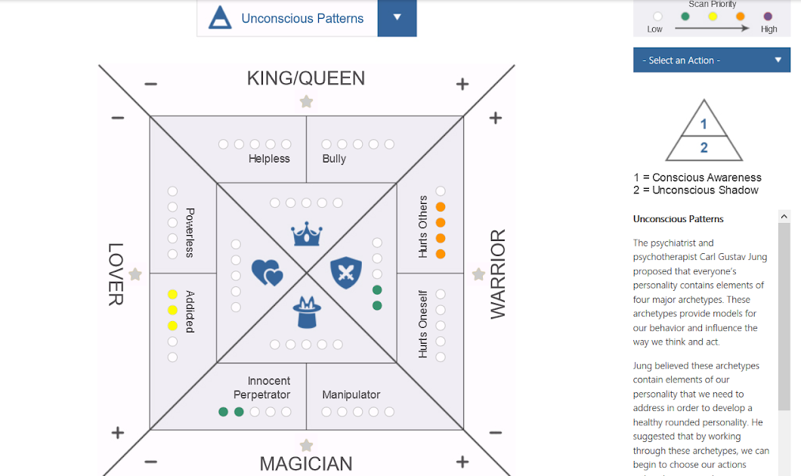

Slide 7
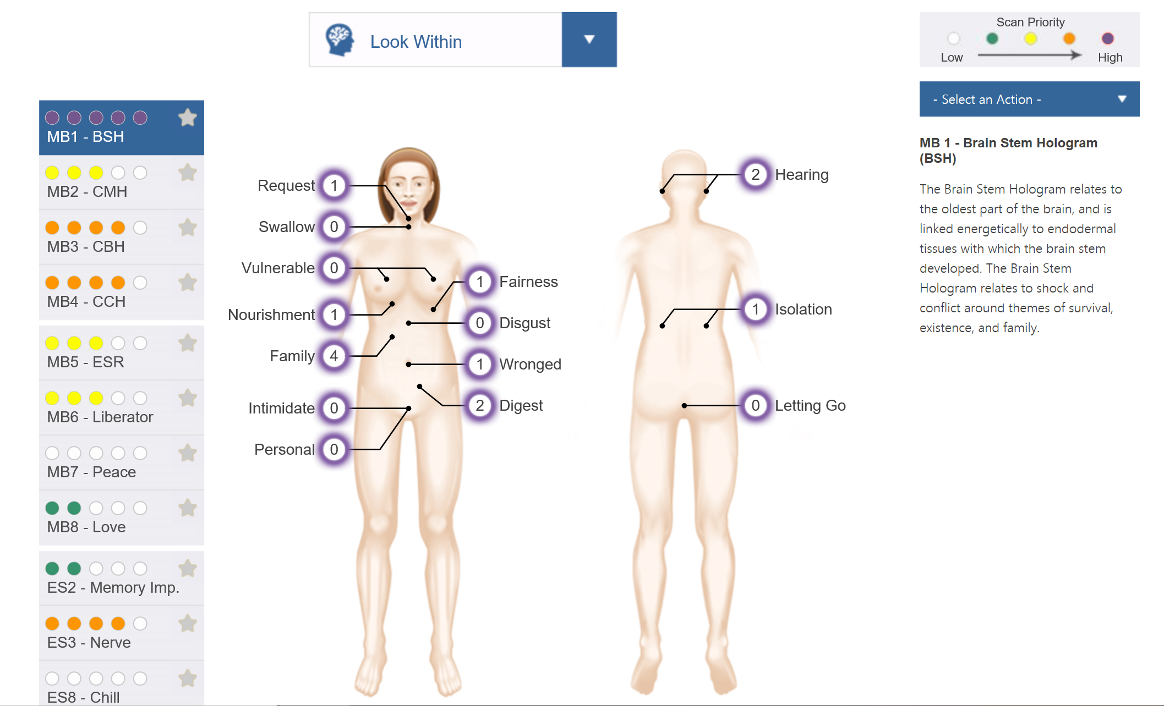
How Trauma Affects Your
Construct of Reality

Slide 8
Break Out Time!
Please take a few minutes to write down your answers.
Then each person takes 2 minutes to discuss with Breakout Room.
After you’re finished, please return to the main meeting room where group leaders can summarize highlights.
1) What is the biggest choice you are facing right now?
2) What is the biggest part of you that needs to change to help you live your purpose?
(This could be based on your scan - ie. Mind-Body, Archetypes, Be The Change etc.)
3) What are you going to do in the next month to take you closer to aligning your purpose?

Slide 9
Stay tuned!
There will be more educational Town Hall meetings in the near future, keep your eye out for invitations!

