Slide 1


Choice Point Masterclass,
Part 2 of 4
Align Your Purpose
Harry Massey & Lenny Izzo

Slide 2
Part 1 – Your & Our Global Choice Point
Replay available in Portal
Part 2 – Align Your Purpose
Monday, May 4 at 6pm ET
Part 3 – Be The Change, Part 1
Monday, May 11 at 6pm ET
Part 4 – Be The Change, Part 2
Monday, May 18 at 6pm ET
Choice Point Masterclass
Webinar Schedule

Slide 3
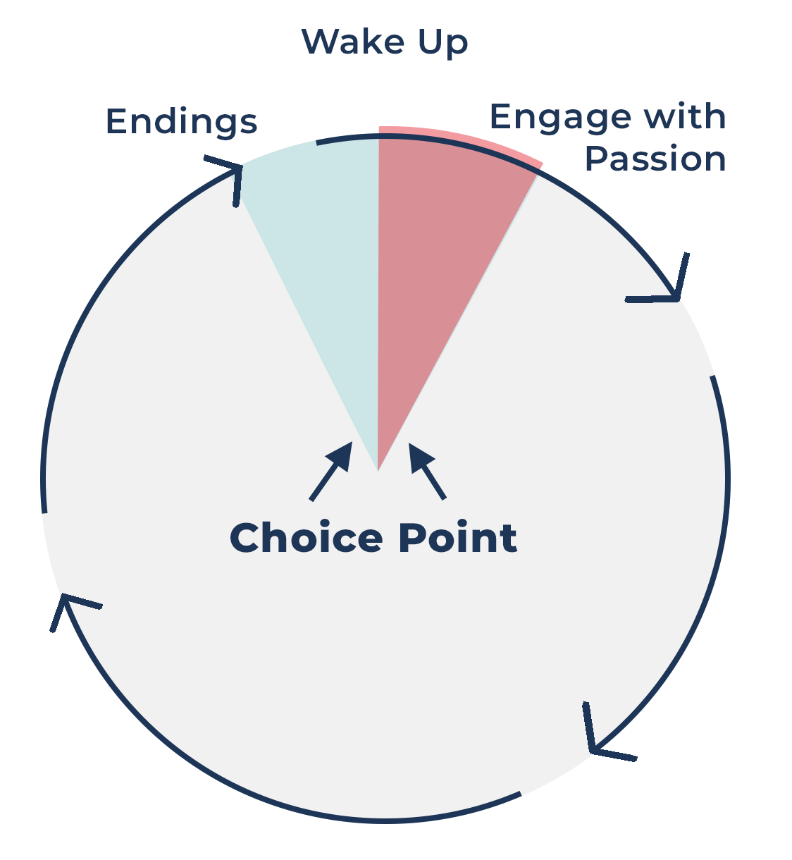
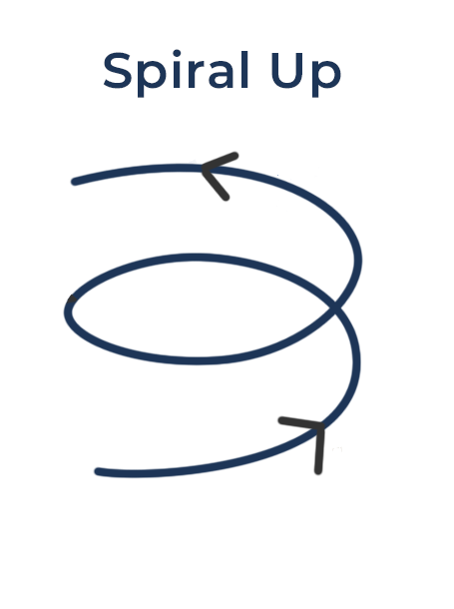
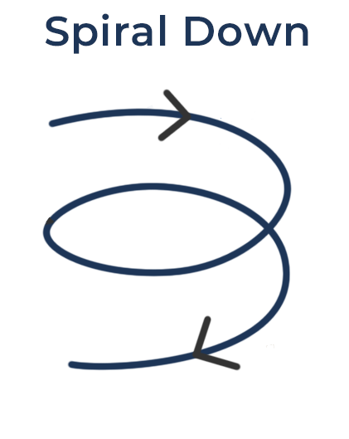
Choice Point
Window of Crisis and Opportunity
OR

Slide 4
Endings (humility)
Window
Wake Up
Engage with Passion

Slide 5


Your Purpose
Unique Ability,
Interest,
Trends
Use your skills for good!

Slide 6

Being aligned with what the world & others want takes
less energy.
Understand Your World and the Trends around you
Example: .
People want better
health & energy,
so others help
make it happen.
Being selfish takes more energy.

Slide 7
Dancing in Time with the Music & the Patterns around you…
Like the wind behind you.
For example…
Due to irrational fear, people will travel less to practitioners;
this will increase virtual consultations;
So, adapt your services to virtual consultations.

Slide 8

Scan Review
Sutton Healy
Life Purpose

Slide 9
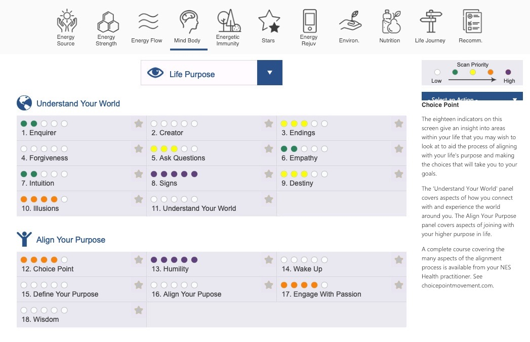

Slide 10
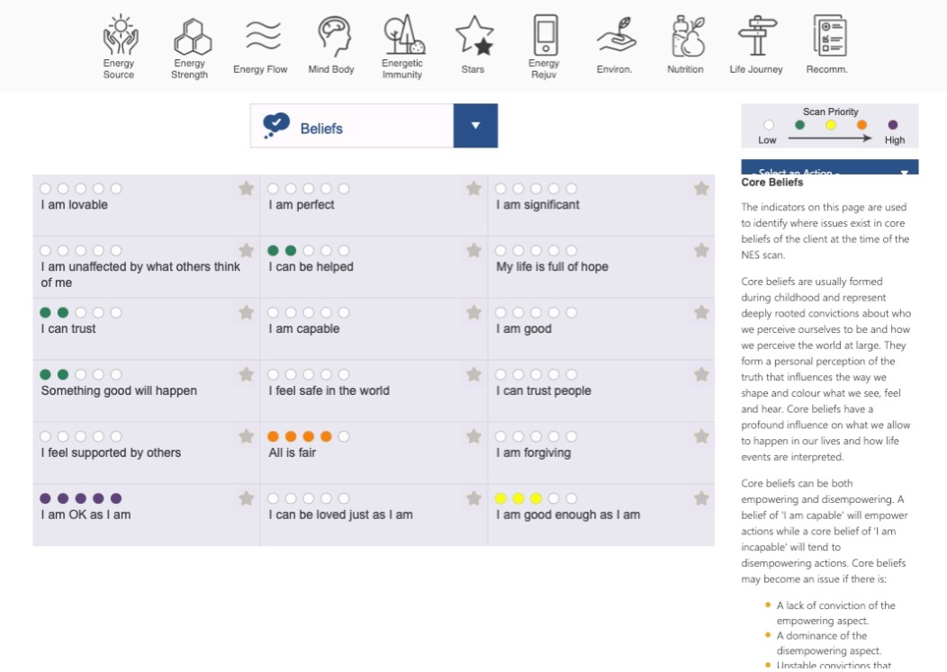

Slide 11
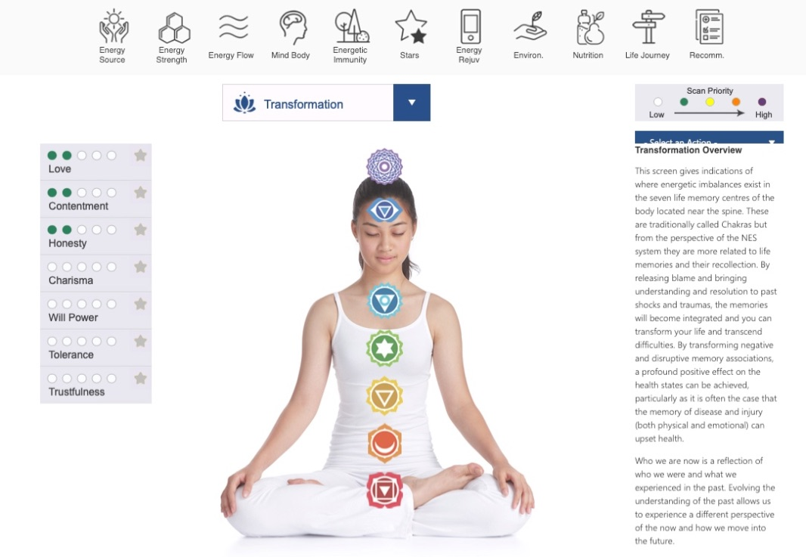

Slide 12
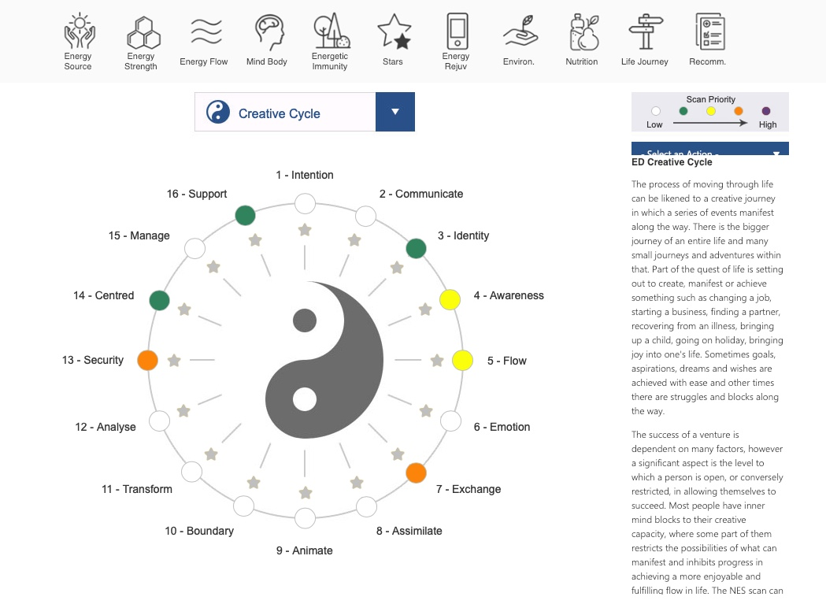

Slide 13
Scan Review
Melinda Mueller
Hero’s Journey

Slide 14
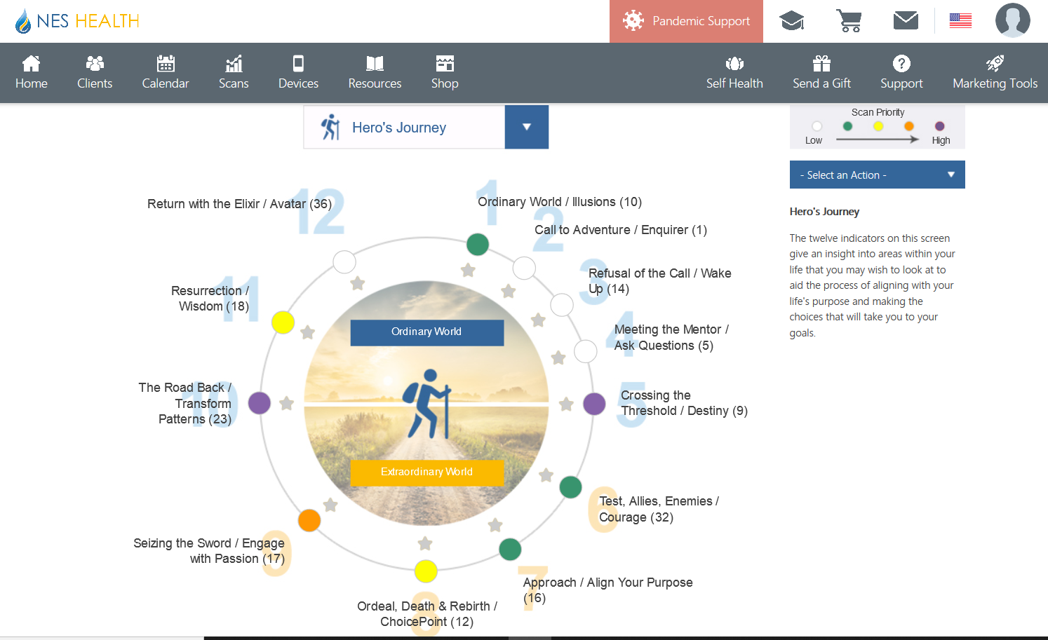

Slide 15
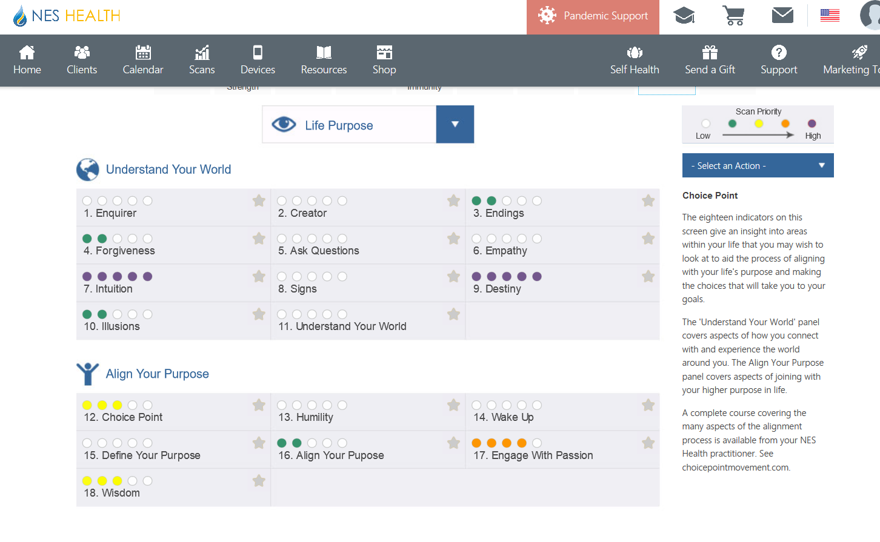

Slide 16
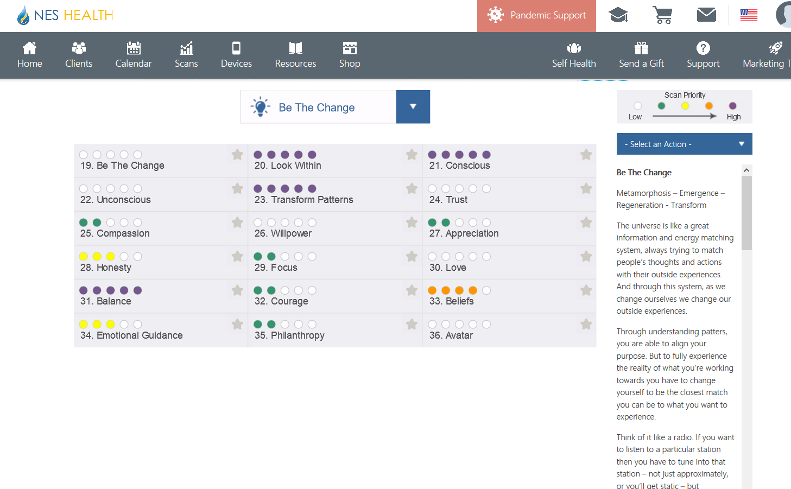

Slide 17
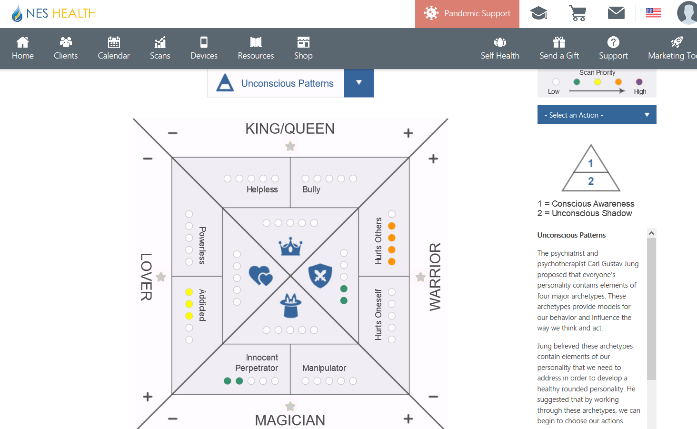

Slide 18
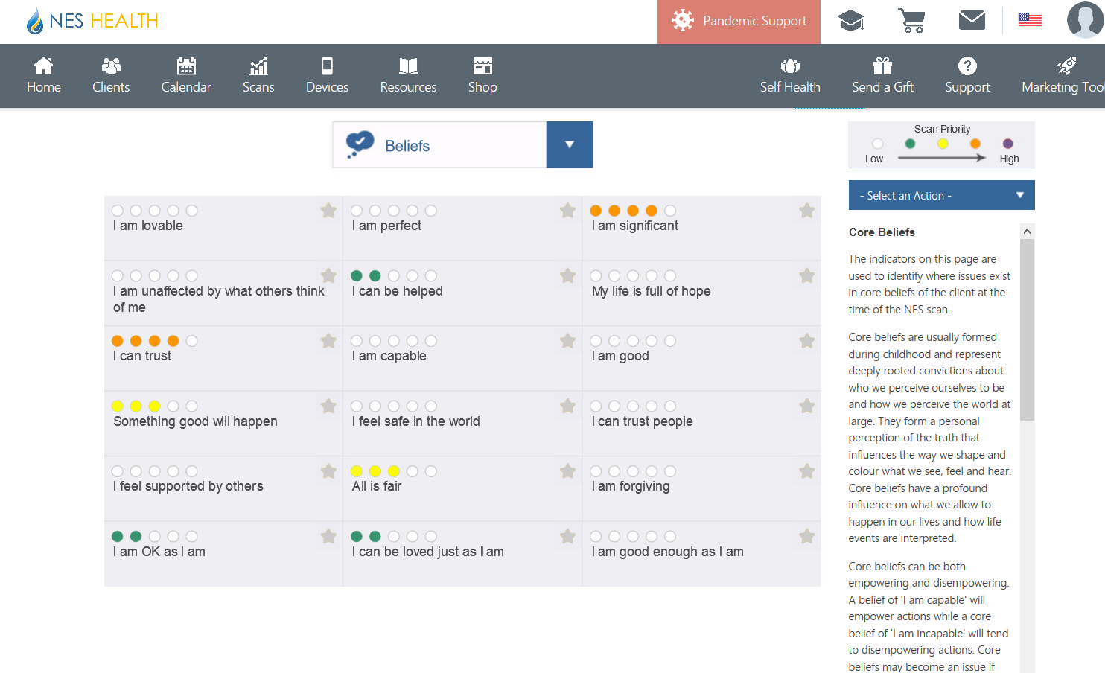

Slide 19
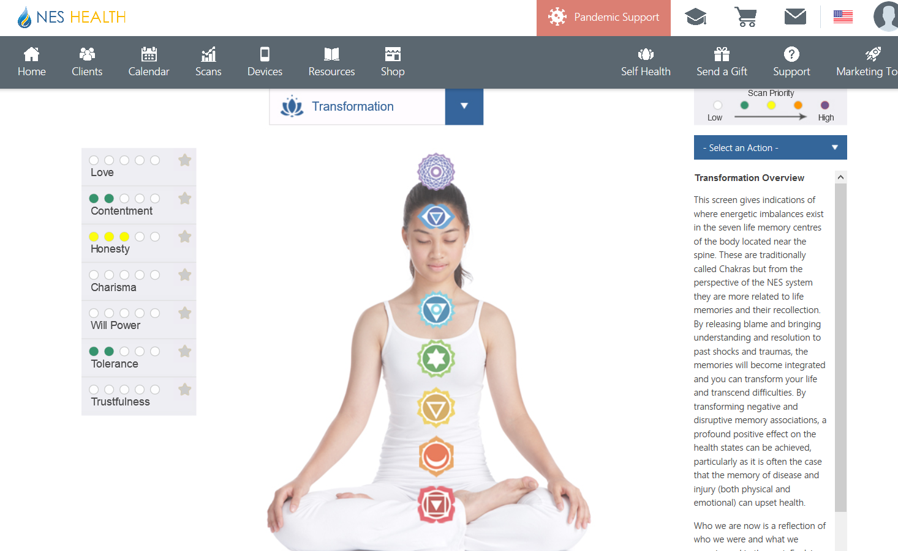

Slide 20
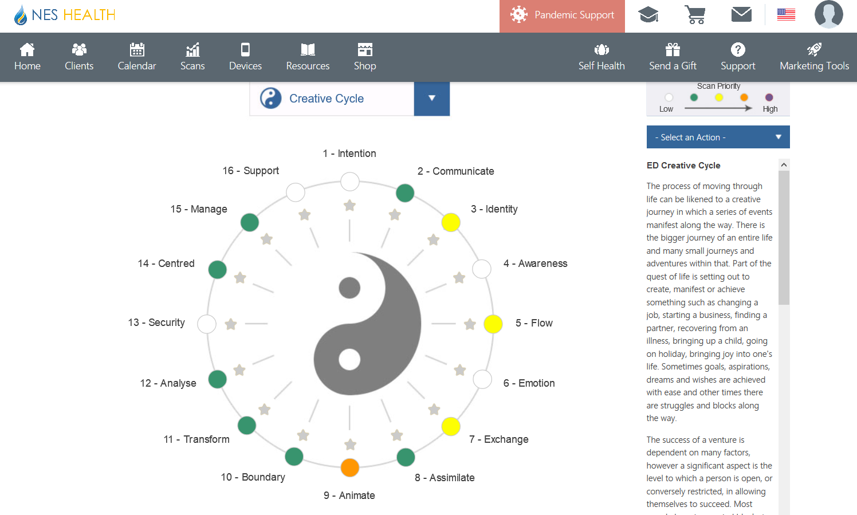

Slide 21
Join us next time!
Part 3 – Be The Change, Part 1
Monday, May 11 at 6pm ET
Part 4 – Be The Change, Part 2
Monday, May 18 at 6pm ET

