Slide 1

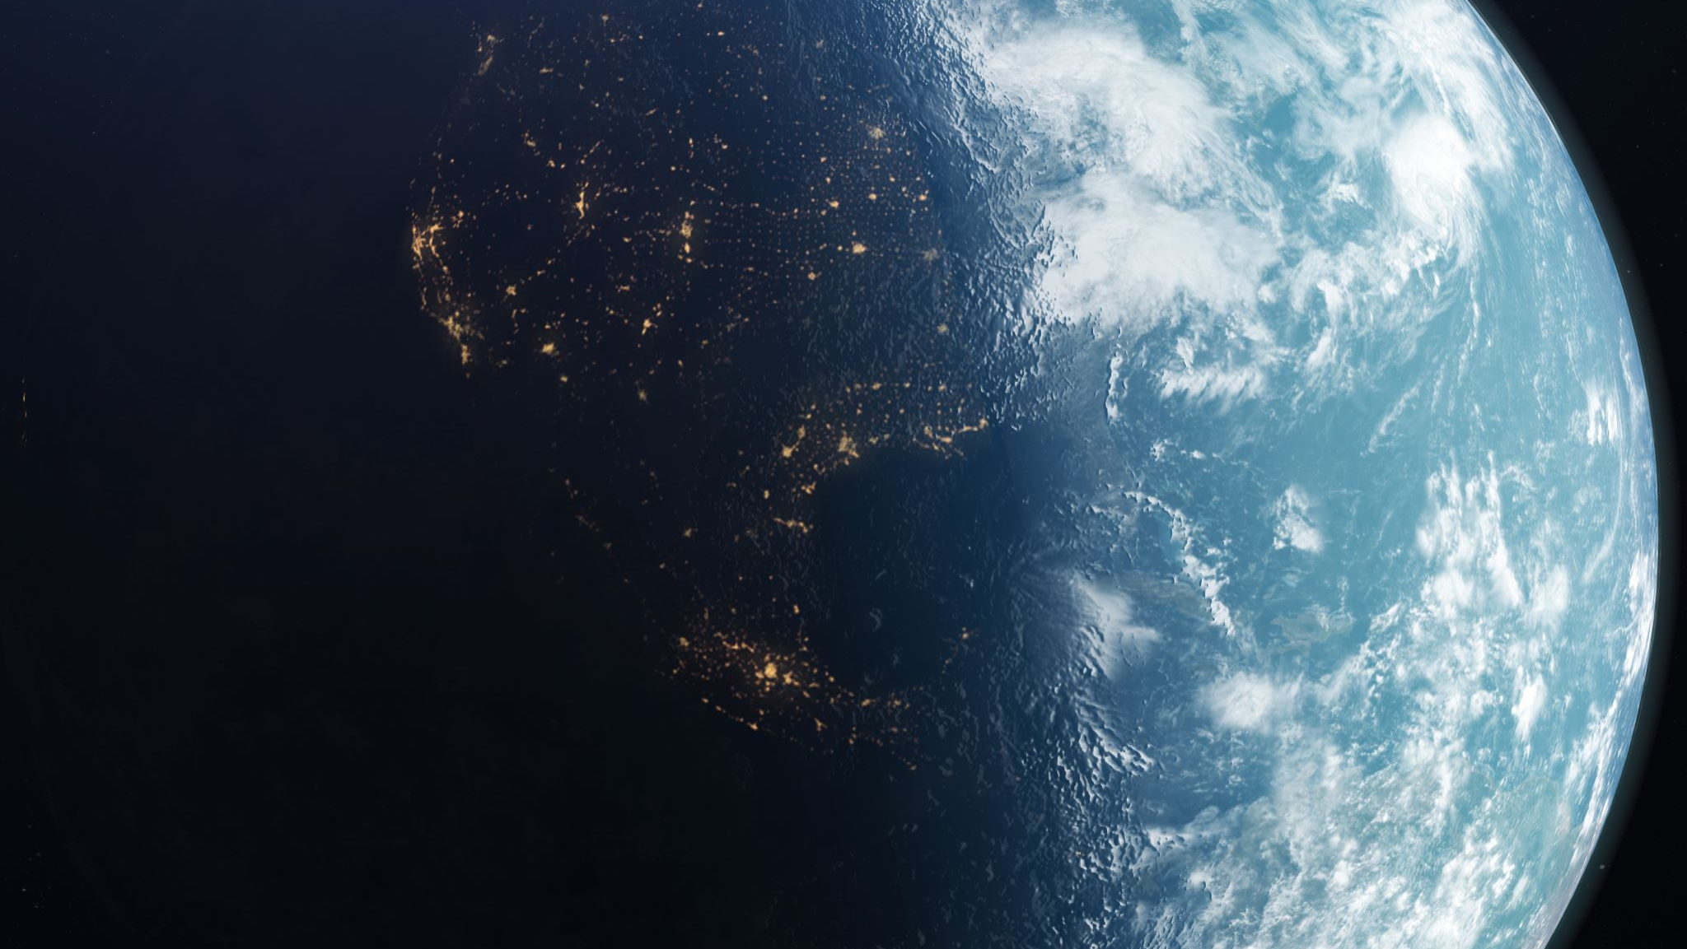
Choice Point Masterclass,
Part 1 of 4
Your &
Our Global
Choice Point
Harry Massey & Lenny Izzo

Slide 2
Part 1 – Your & Our Global Choice Point
Monday, April 27 at 6pm ET
Part 2 – Align Your Purpose
Monday, May 4 at 6pm ET
Part 3 – Be The Change
Monday, May 11 at 6pm ET
Part 4 – Transformation
Monday, May 18 at 6pm ET
Choice Point Masterclass
Webinar Schedule

Slide 3
Napoleon Hill wrote a book called “Outwitting The Devil” in 1938.
When he was talking about the causes of epidemics of disease,
financial depression, wars & crime waves:
“All such epidemics in which great numbers of people
are similarly affected are caused by the law of hypnotic rhythm, through which nature consolidates thoughts of a similar nature and causes those thoughts to be expressed through mass action”

Slide 4

Your & the Global Choice Point
Your Call to have independent thoughts & Understand Your World
Your Call to Align Your Purpose
Your Call to go from the Love of Power to the Power of Love
Your Call to go on Your Hero’s Journey
Your Call to go from Crisis to Co-operation

Slide 5
6 LAWS OF UNDERSTANDING YOUR WORLD
No 1: The Law of Universal Self Awareness
No-thing to experience itself became some-thing
Vibrating energy, fractal, interconnected & conscious
Self-Aware
The Enquirer

Slide 6
6 LAWS OF UNDERSTANDING YOUR WORLD
No 2: The Law of Resonance
How the Universe communicates with itself
Everything is Vibration from thoughts, electrons to galaxies
Energy & Information; E = mc²
Is it reality that is in a choice point or is it you?
Is the world a reflection of you ?

Slide 7
6 LAWS OF UNDERSTANDING YOUR WORLD
No 3: The Law of Attraction
The Outer World Created by Our Inner World
Quantum Physics & The Observer Effect
The Creator

Slide 8
6 LAWS OF UNDERSTANDING YOUR WORLD
No 4: The Law of Oscillation
Tiny vibrations to Planetary & Intergalactic cycles – moon, hormones, day/night
Quantum, Human & Cosmic Realms
Cycles in Time – History, Astrological & Personal
Free Will & Destiny - The more aligned with larger patterns your free will is,
the more destiny-like your life is
Many things are possible, but not everything is likely
Key to Understanding Your World is Pattern & Cycle Recognition:
  Research, Questions, Empathy, Intuition & Signs

Slide 9
6 LAWS OF UNDERSTANDING YOUR WORLD
No 5: The Law of Opposites
Energy in one direction builds equal energy in the other

Slide 10
6 LAWS OF UNDERSTANDING YOUR WORLD
No 6: The Law of Transmutation
Focus on the positive virtue above and in the middle of the pair of opposites
Focusing on an unrelated virtue doesn’t work
Key to Being The Change

Slide 11

Scan Review
Deise Russell

Slide 12
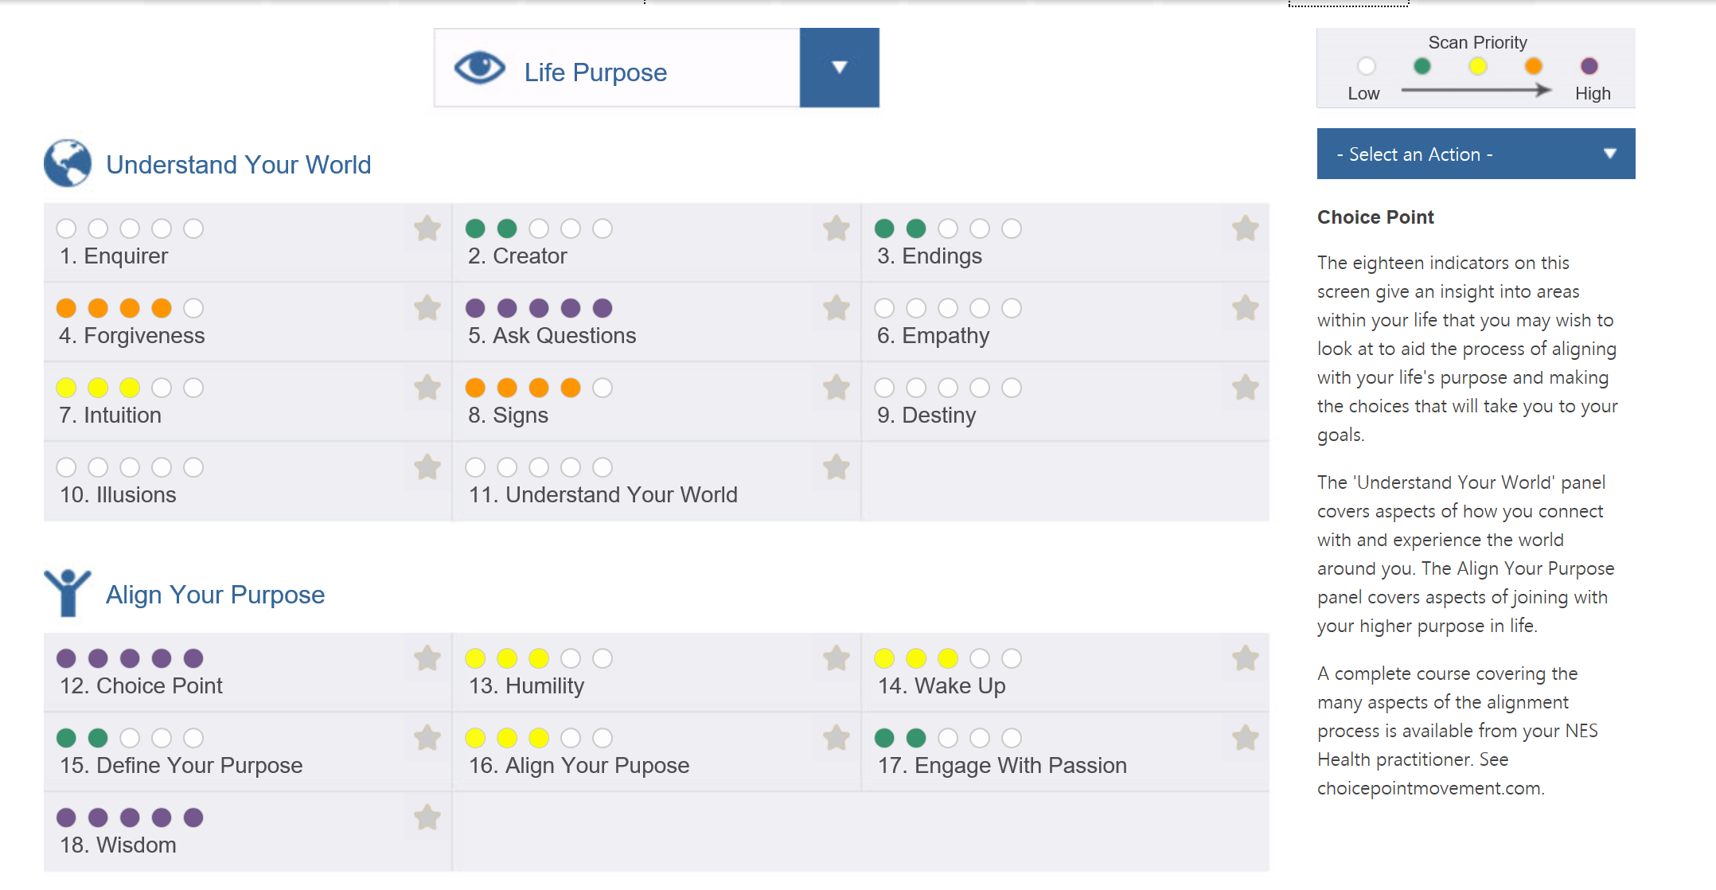

Slide 13
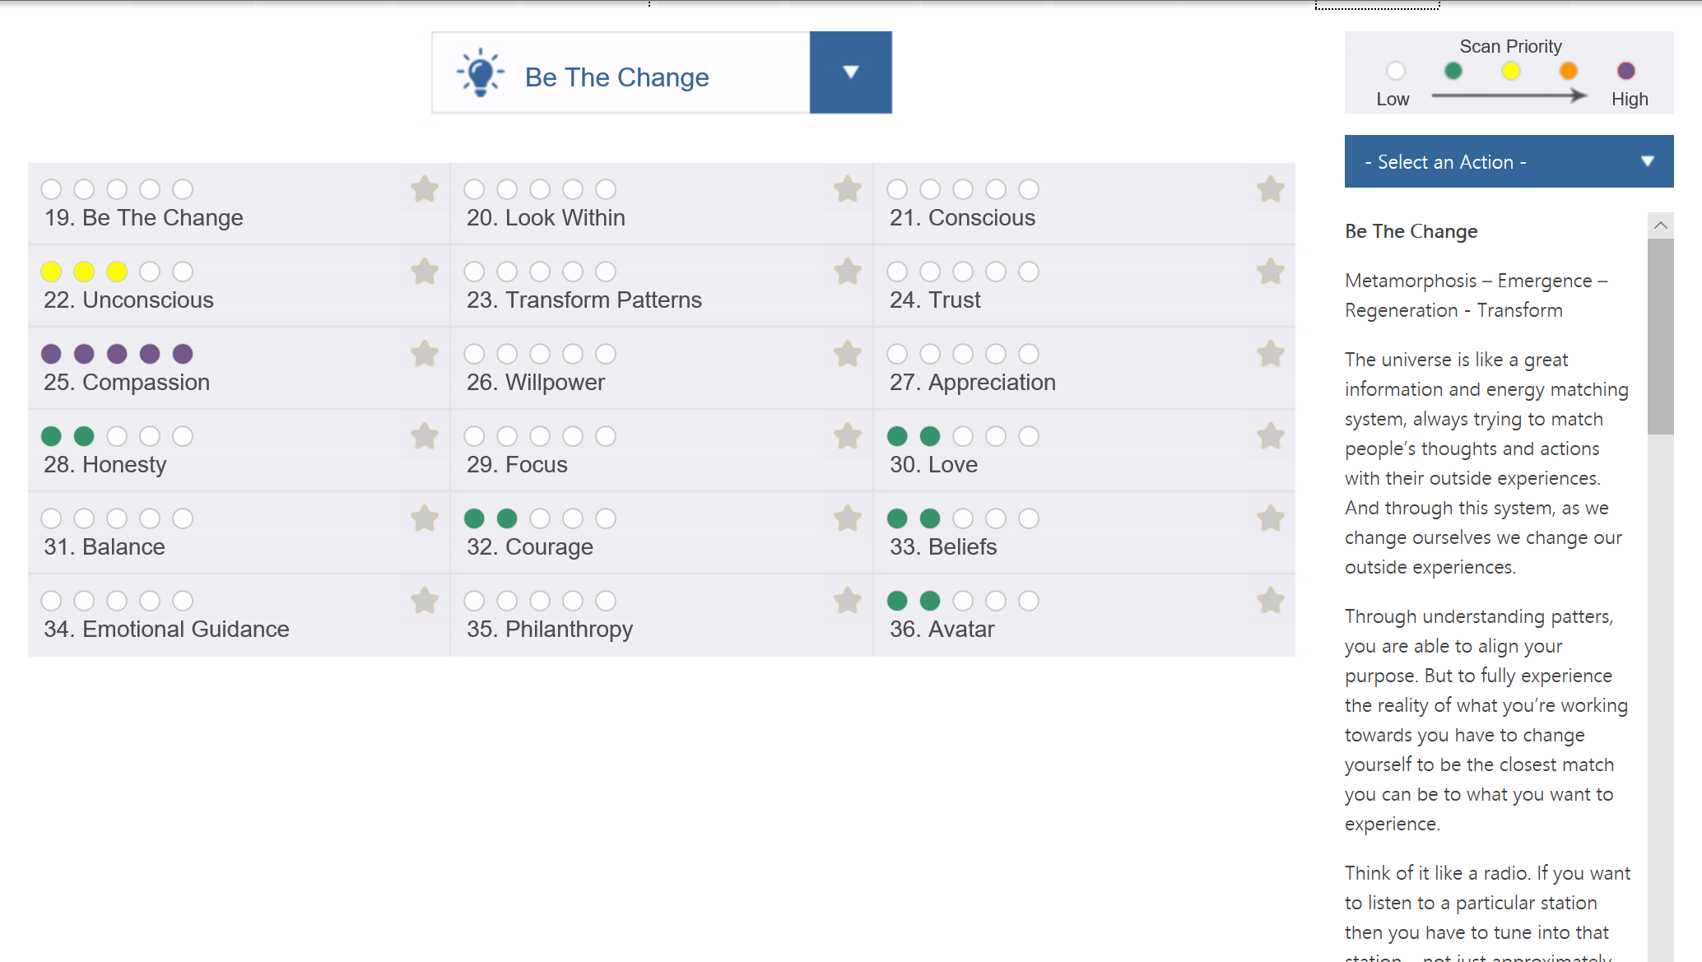

Slide 14
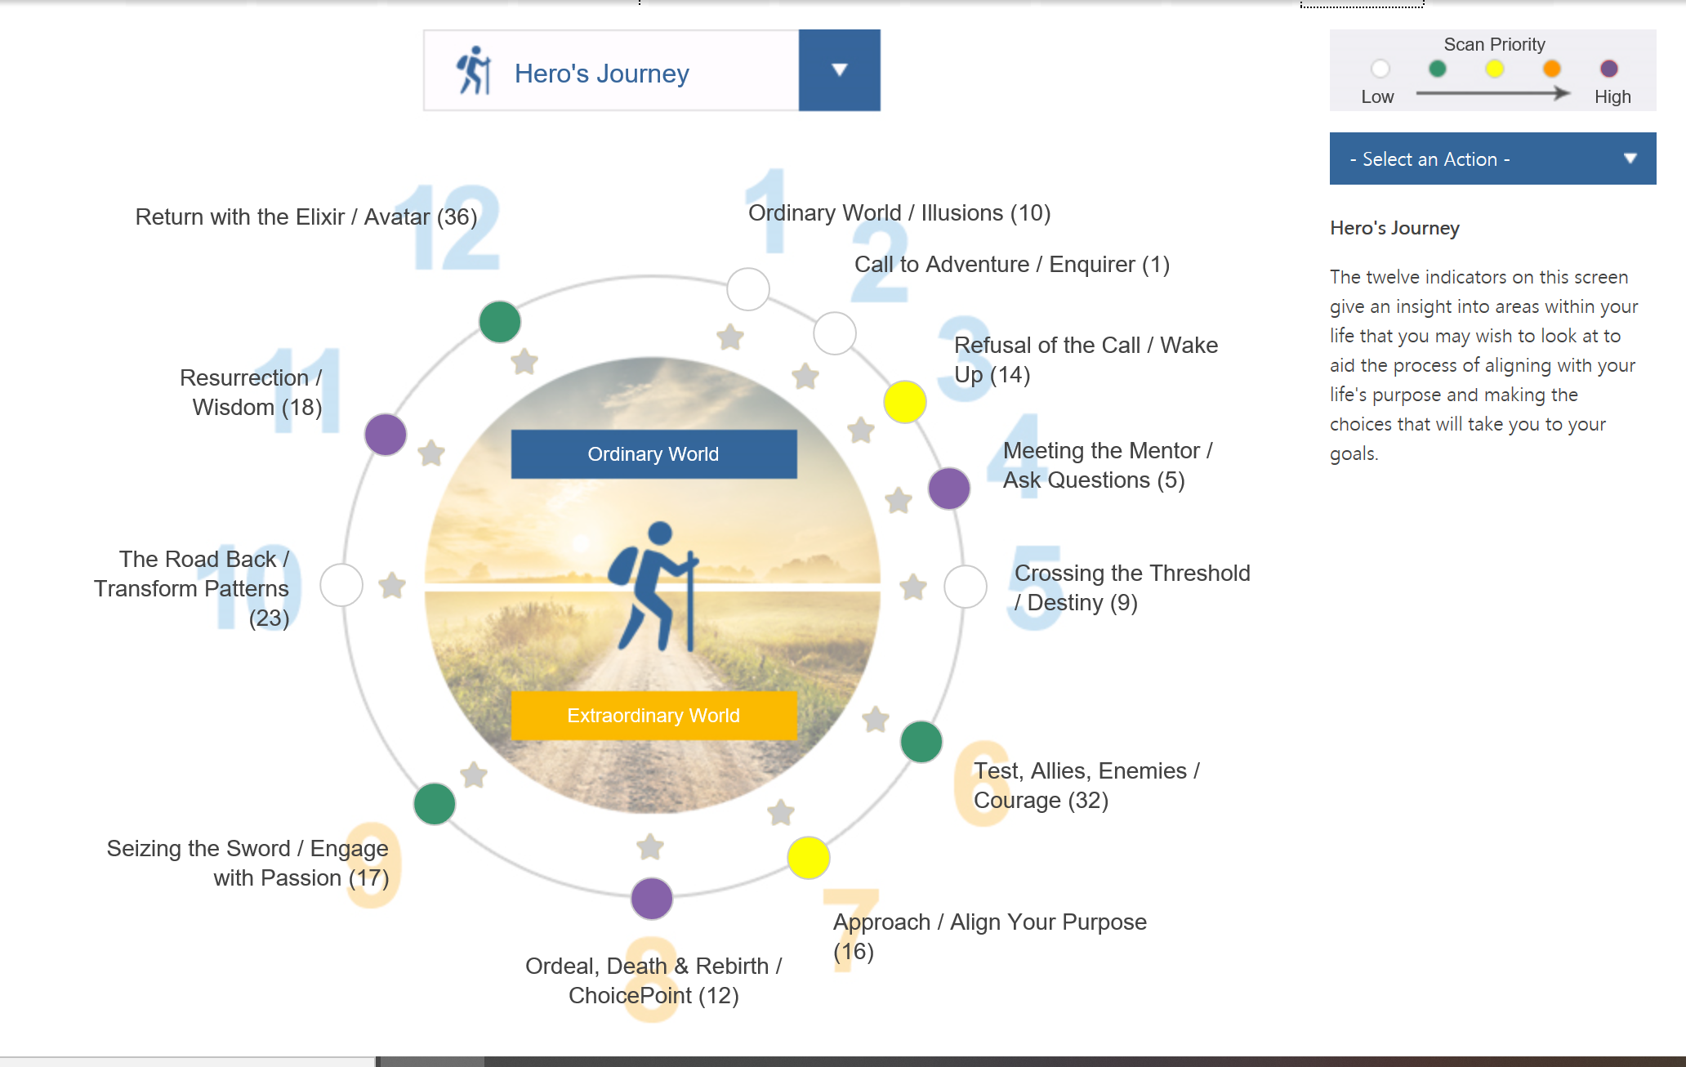

Slide 15
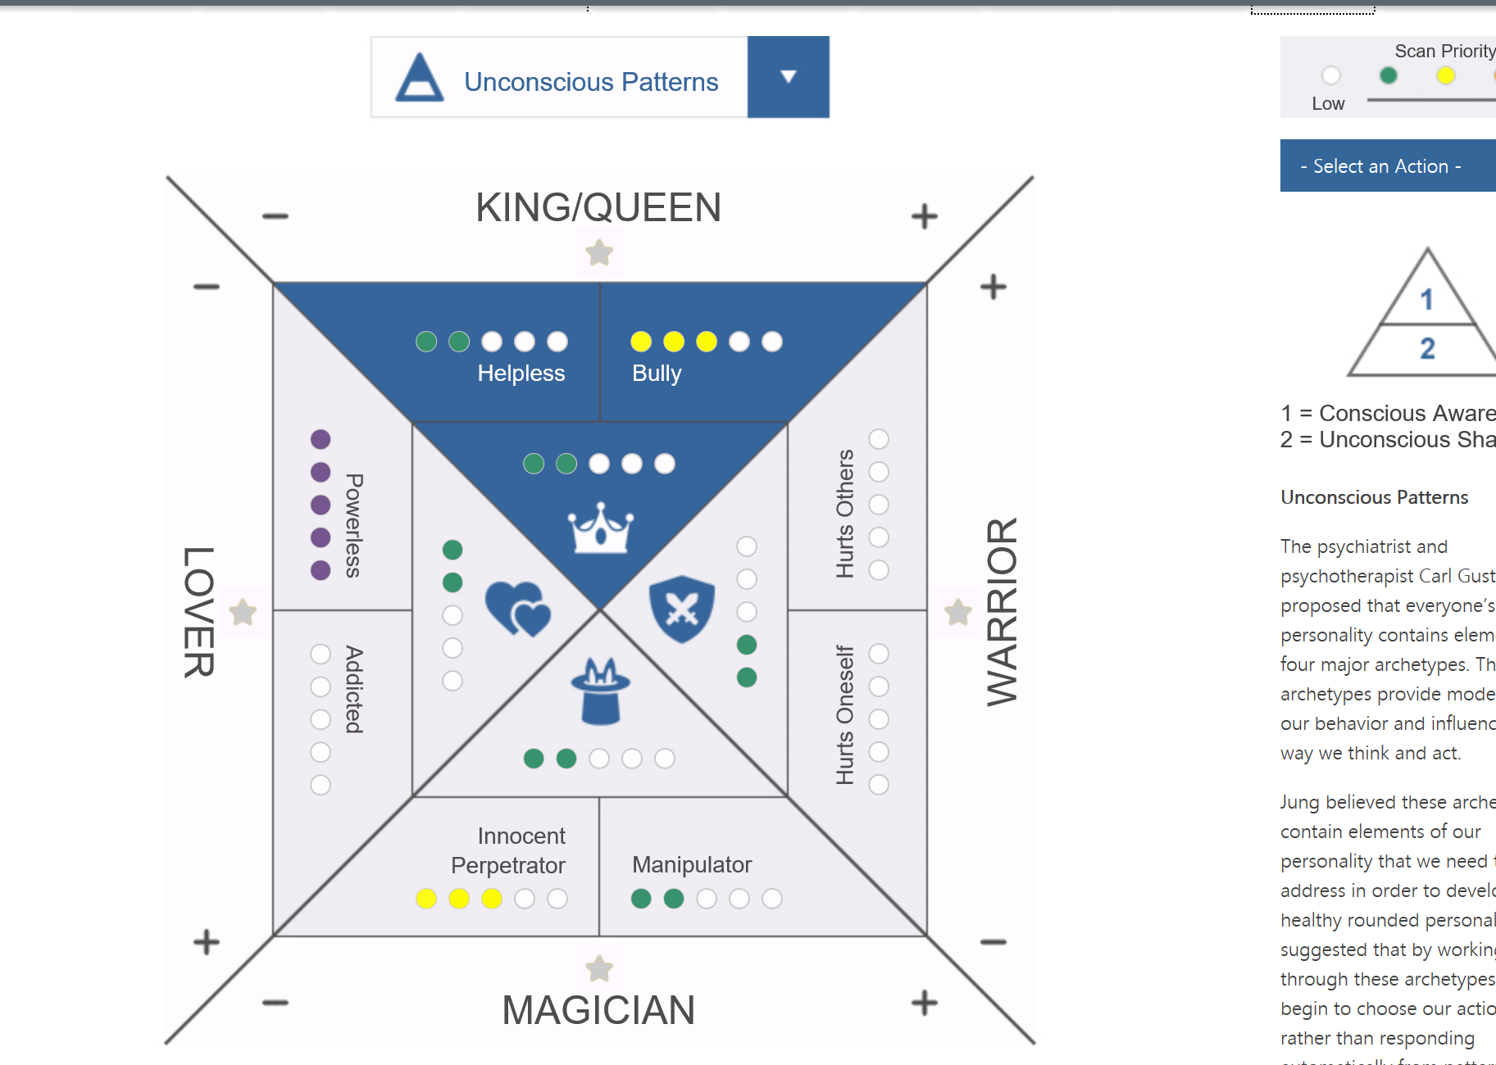

Slide 16
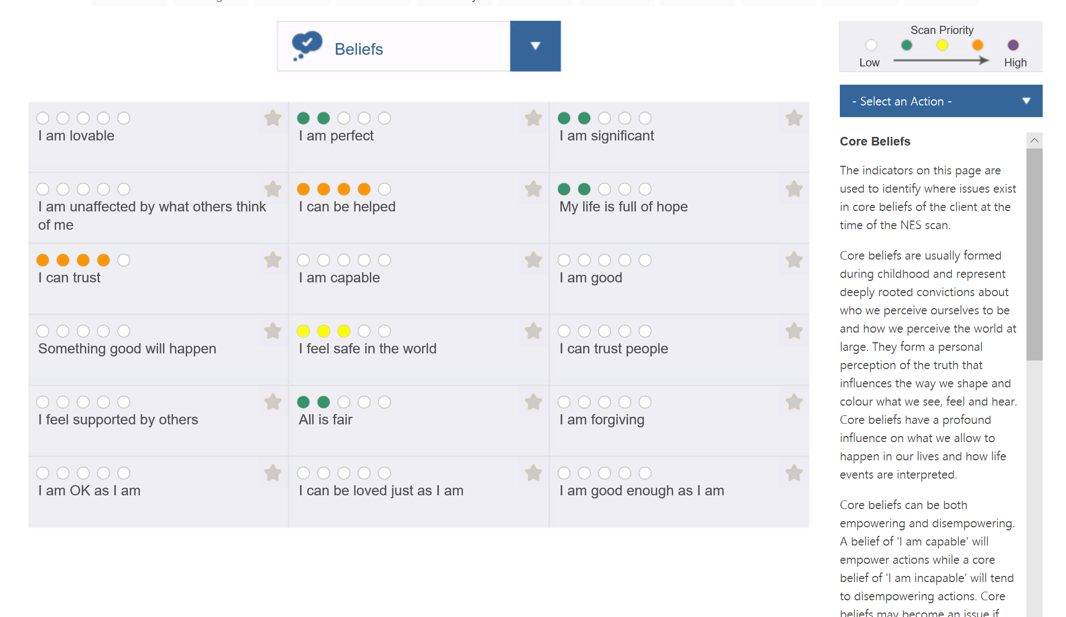

Slide 17
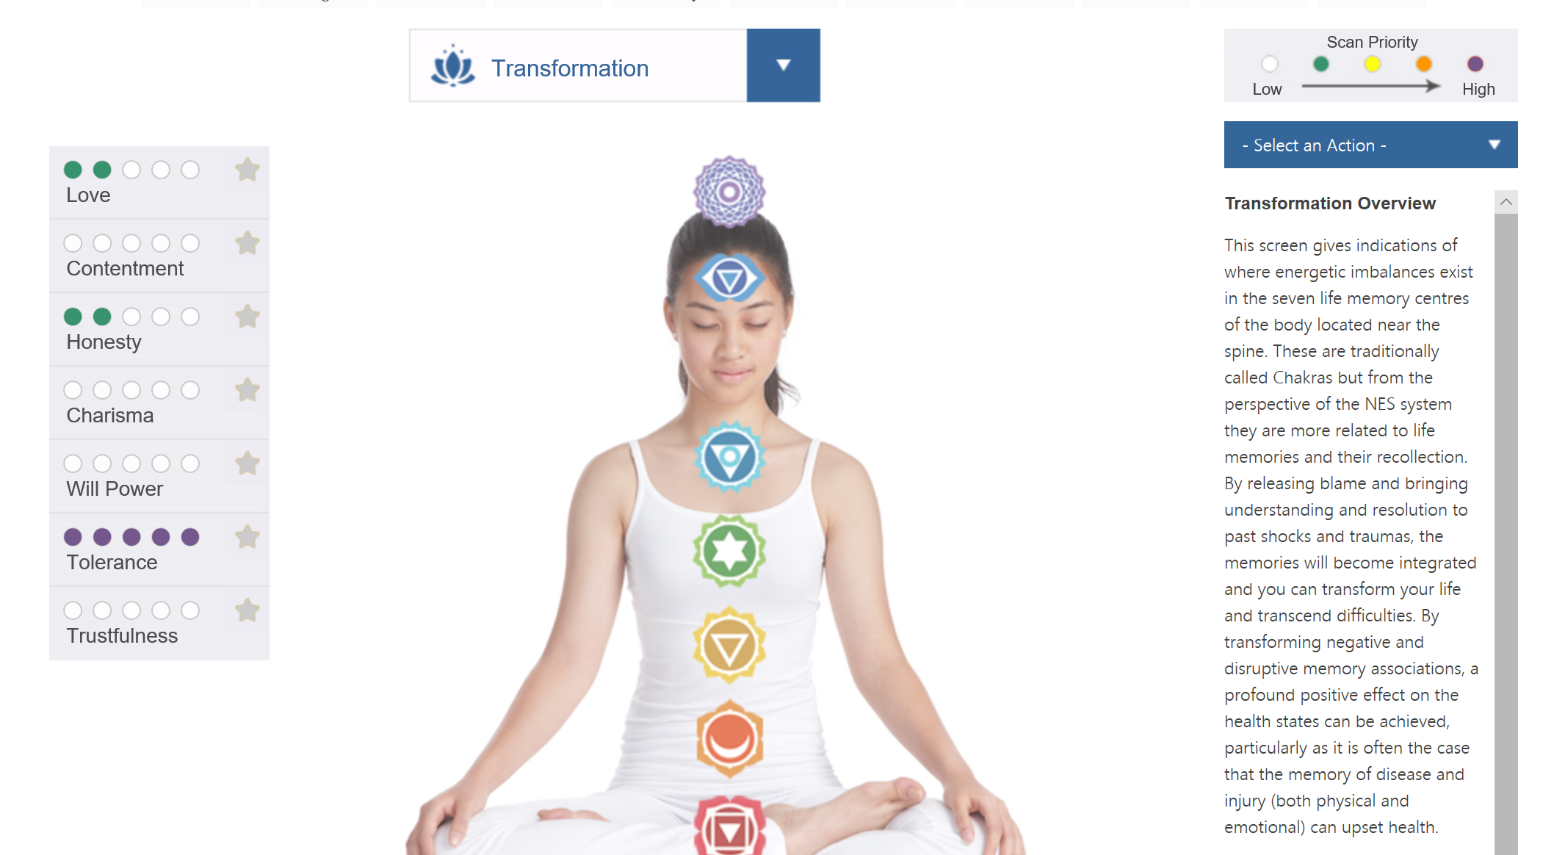

Slide 18
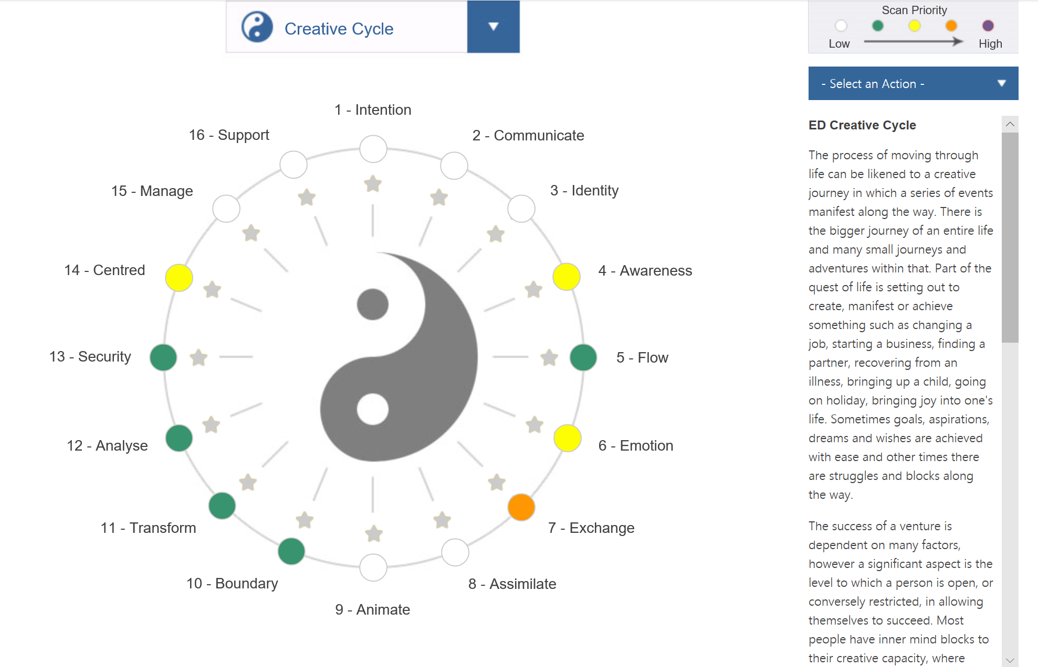

Slide 19
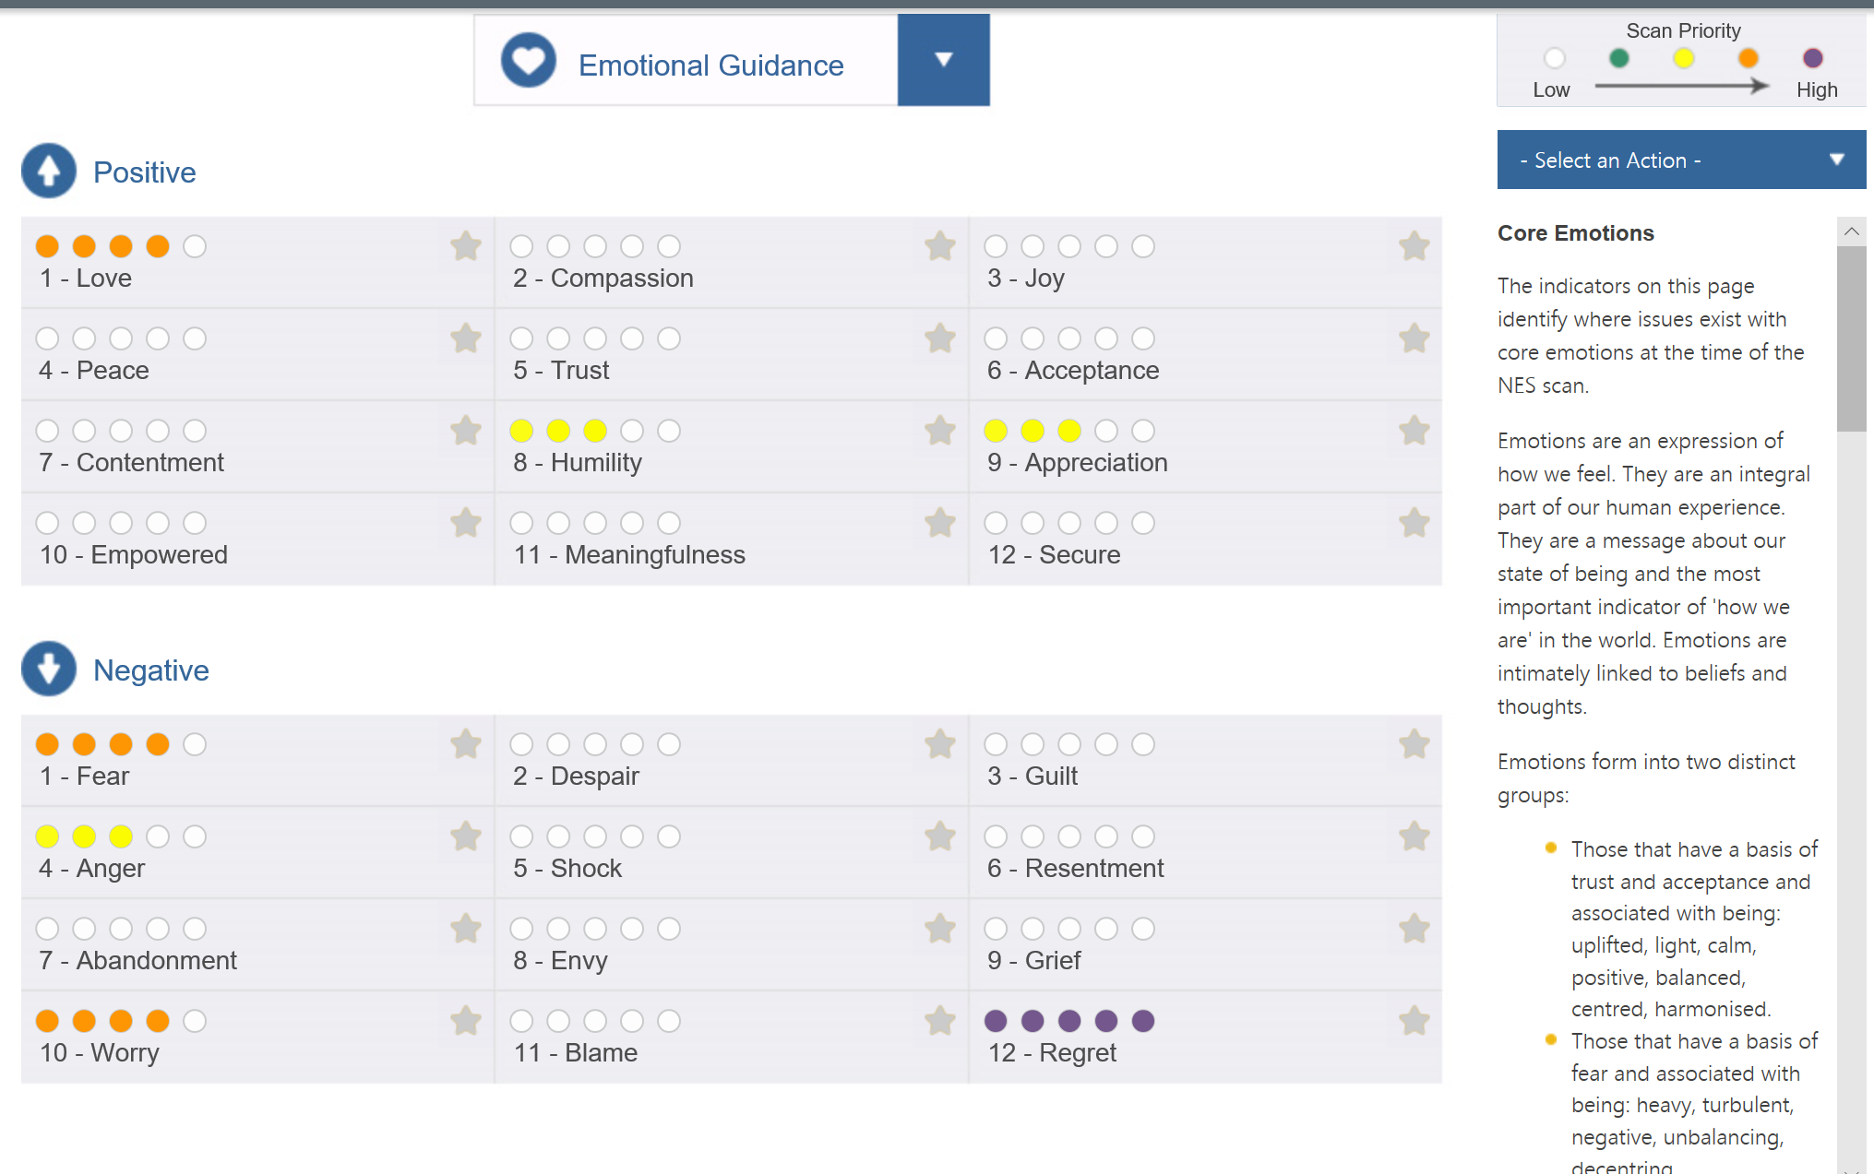

Slide 20
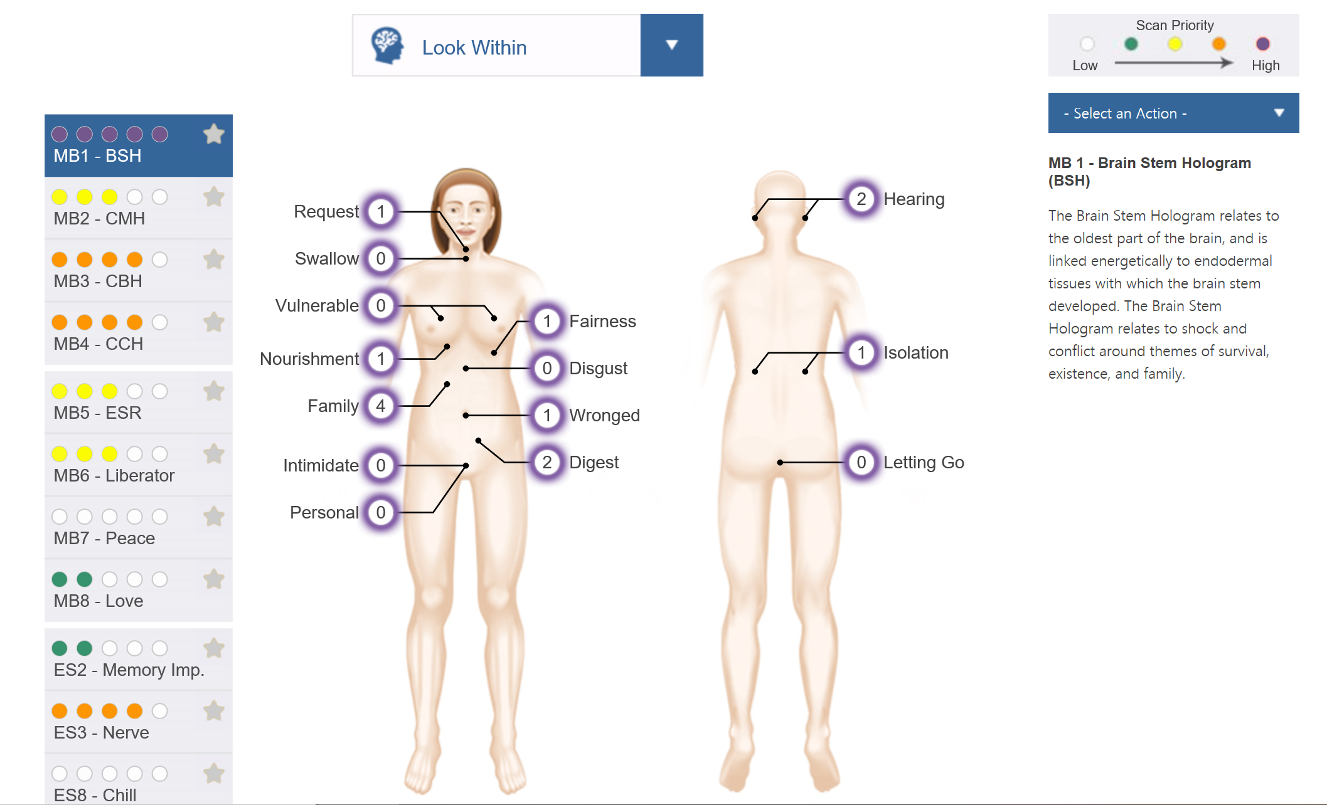

Slide 21
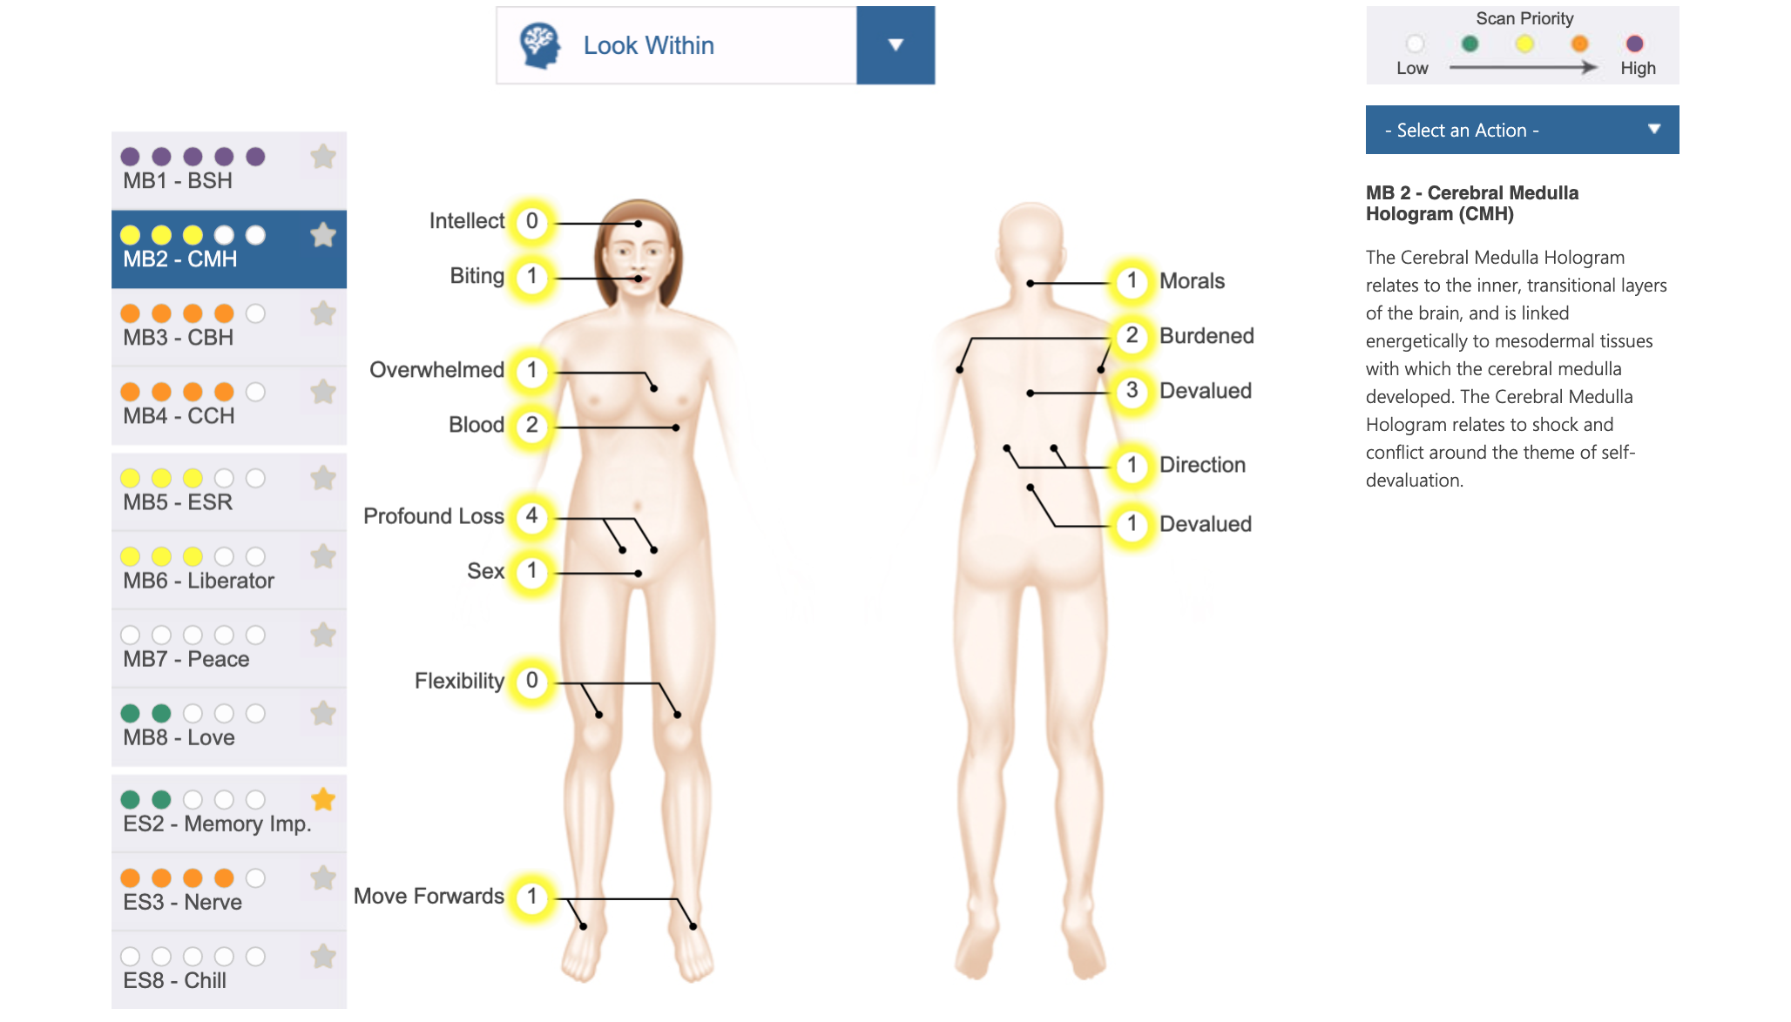

Slide 22
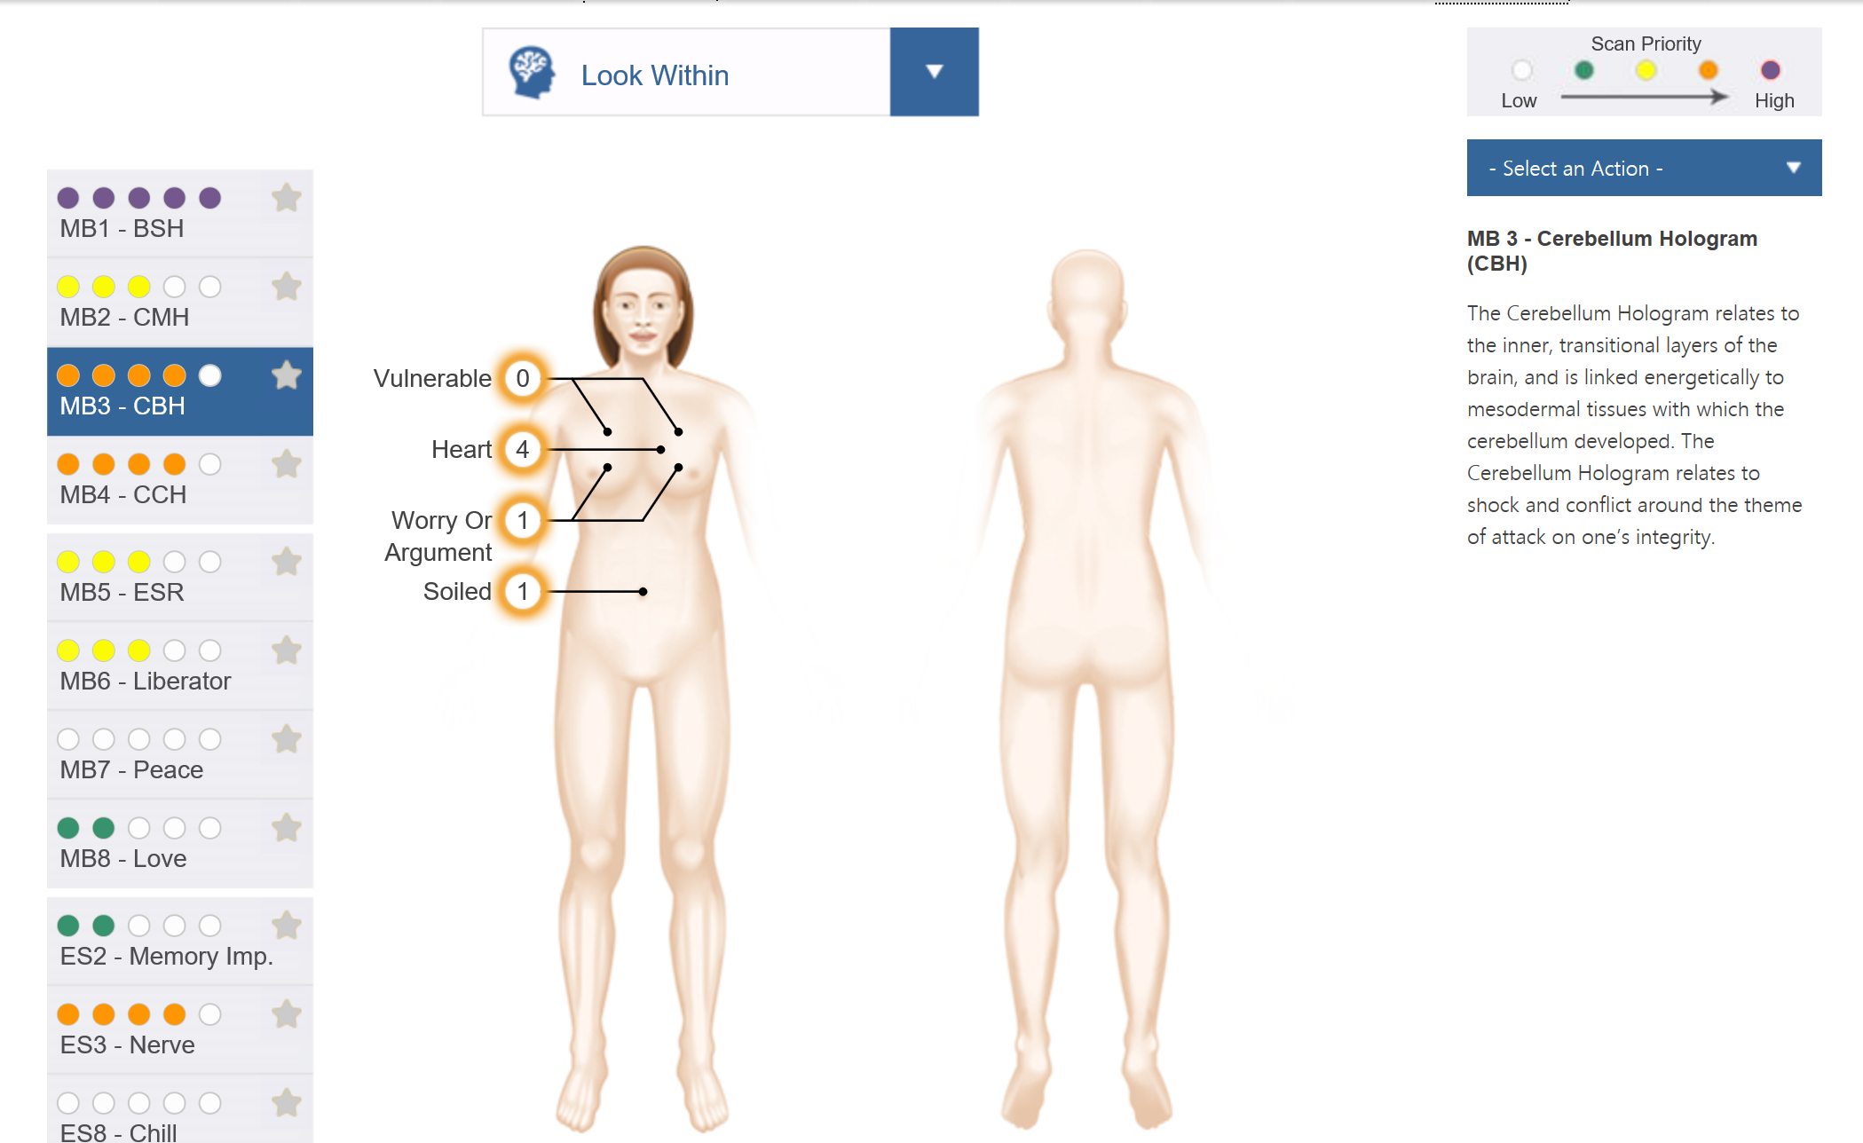

Slide 23
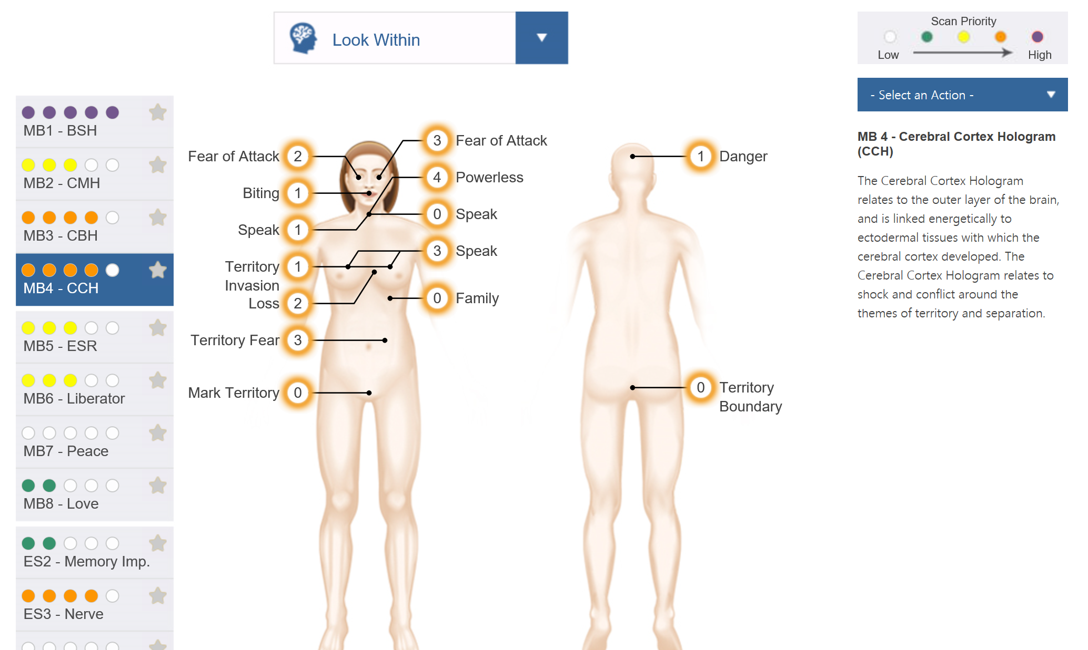

Slide 24
Scan Review
Kat Sheremetyev

Slide 25
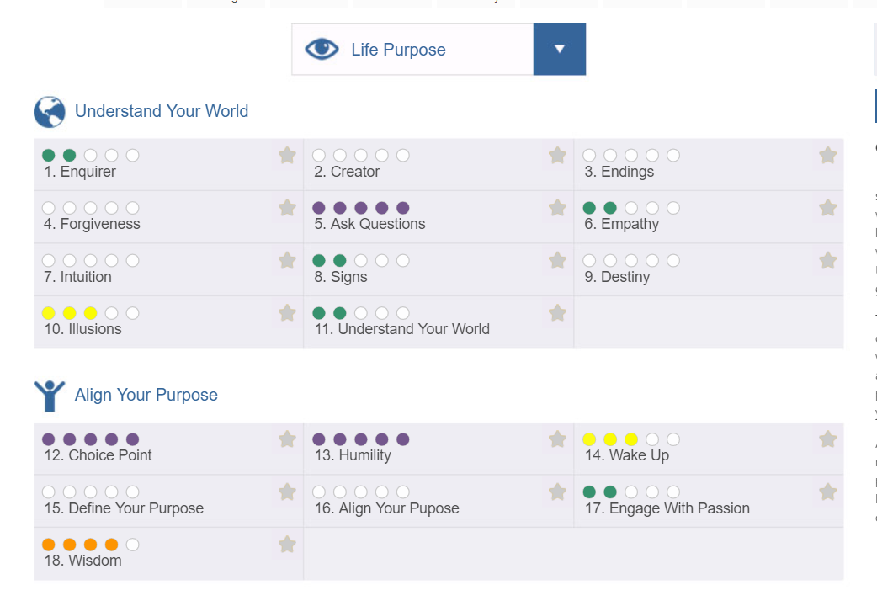

Slide 26
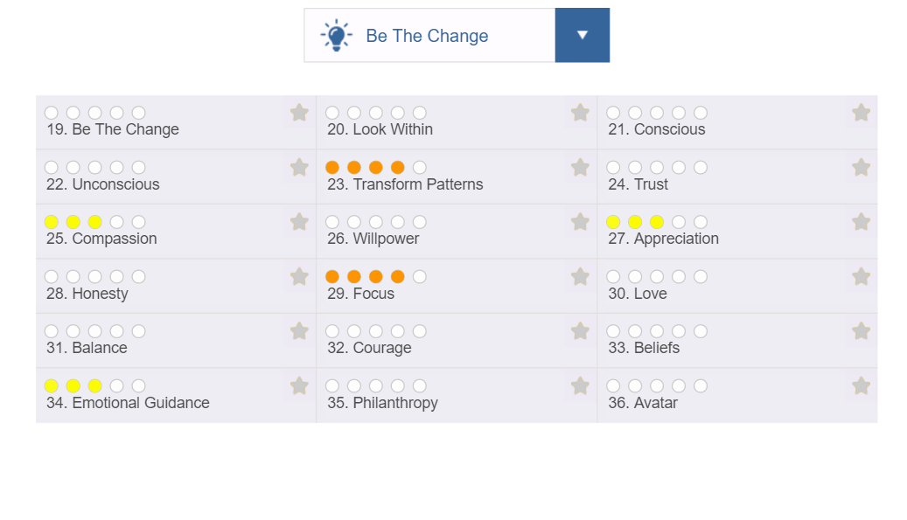

Slide 27
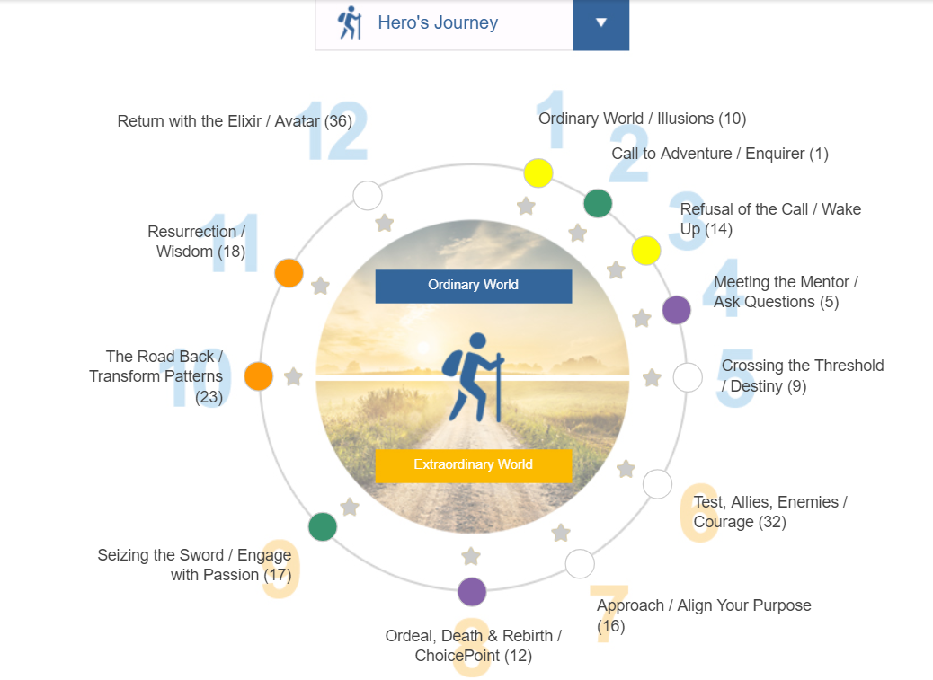

Slide 28
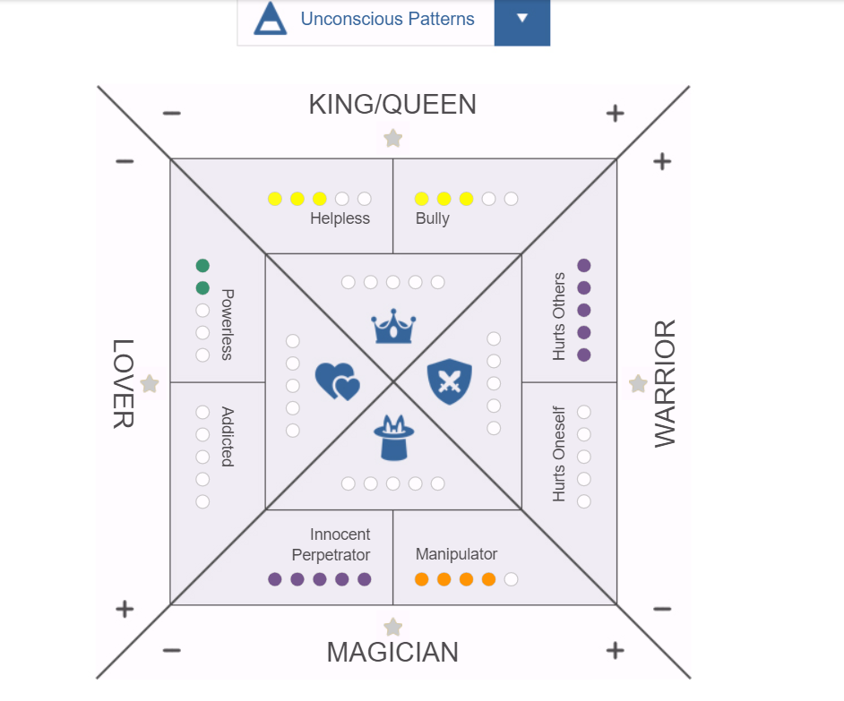

Slide 29
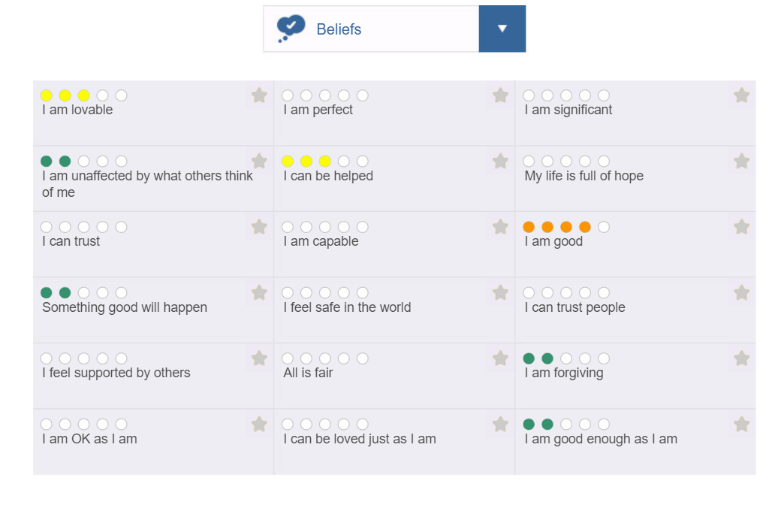

Slide 30
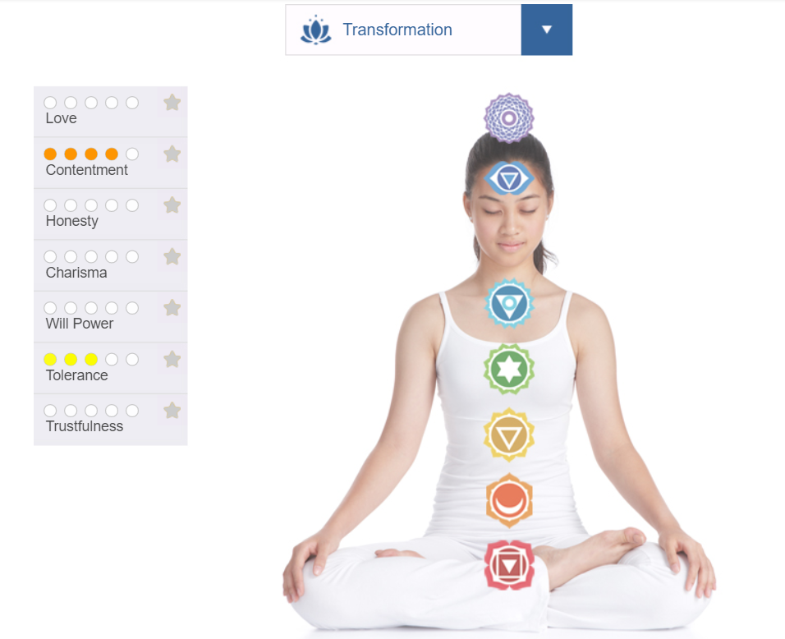

Slide 31
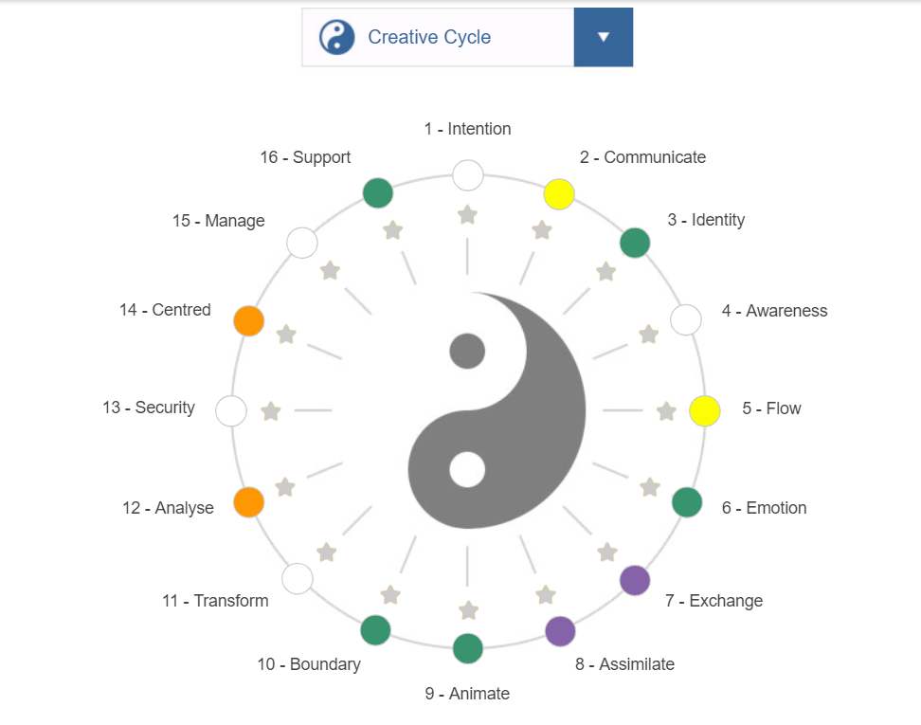

Slide 32
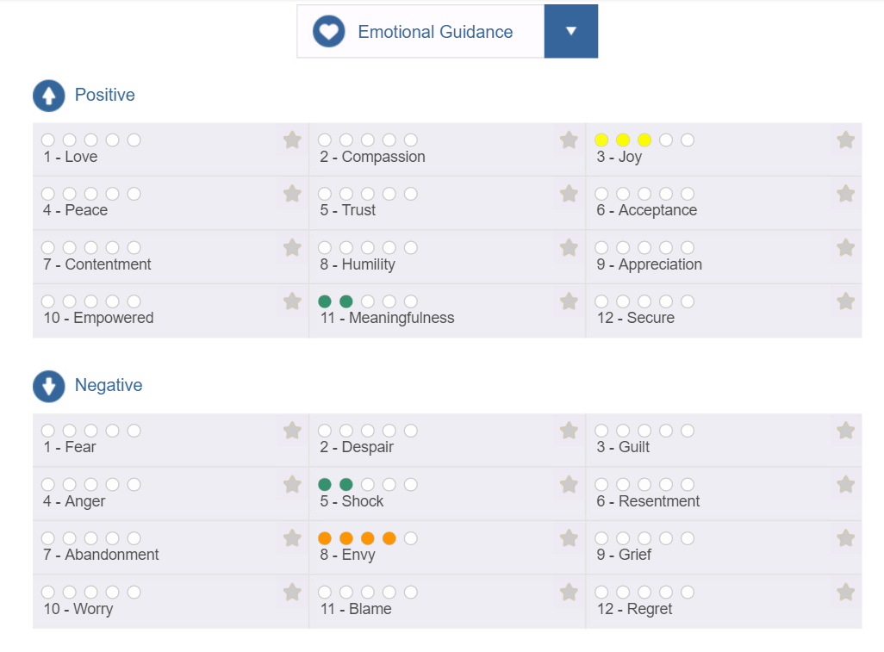

Slide 33
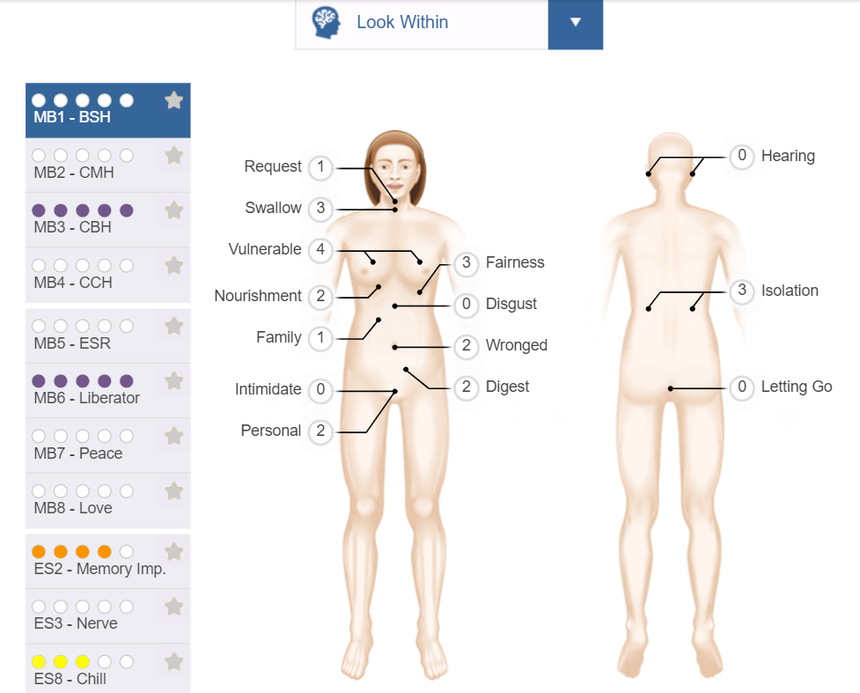

Slide 34
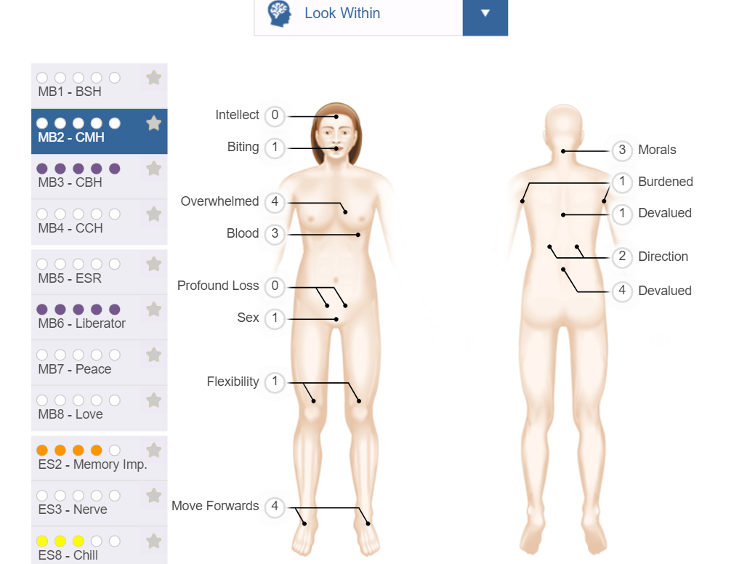

Slide 35
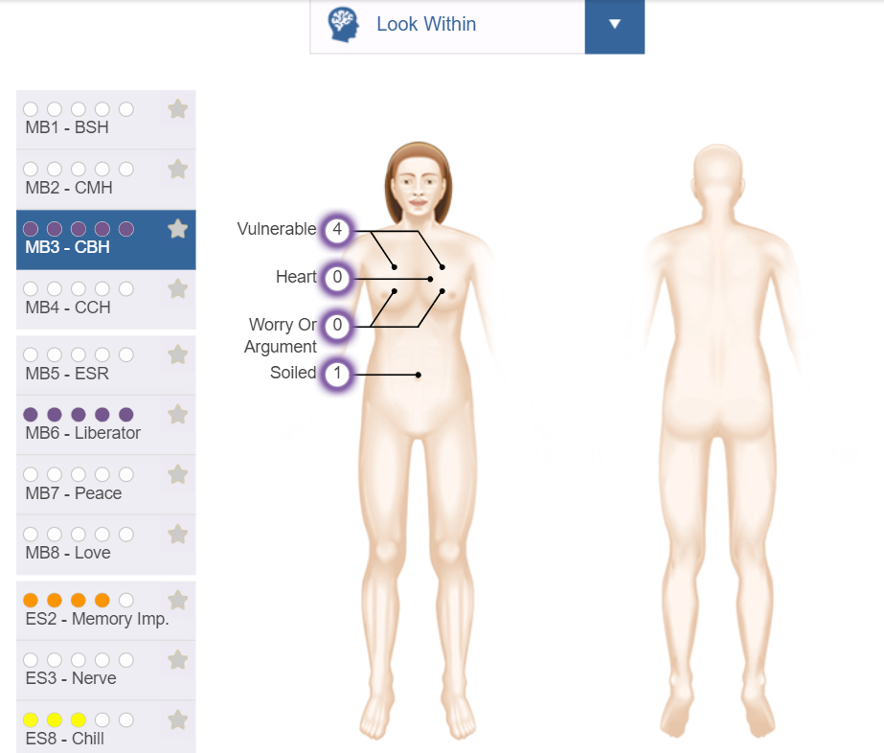

Slide 36
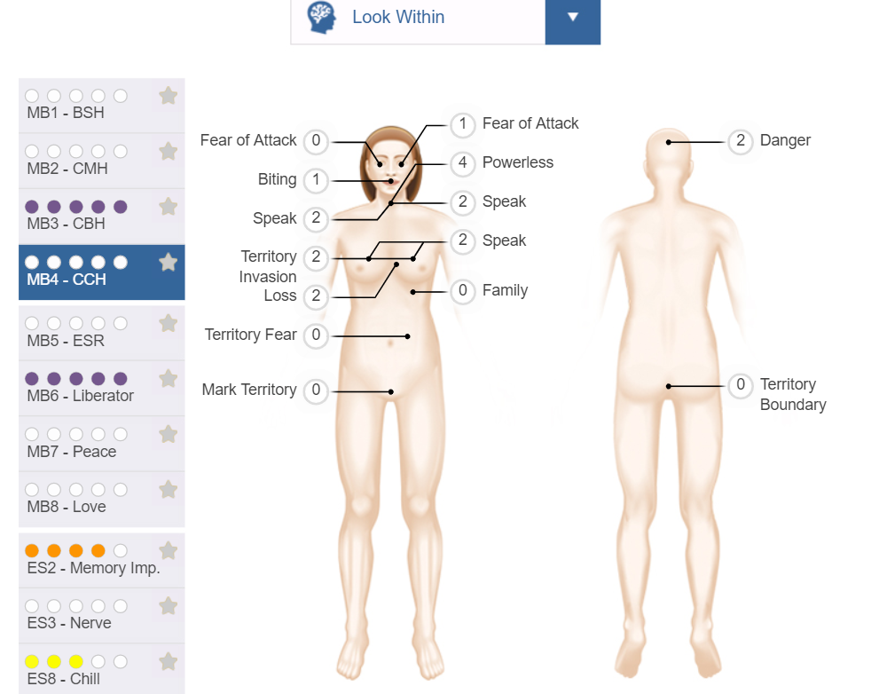

Slide 37


Slide 38
Join us next time!
Part 2 – Align Your Purpose
Monday, May 4 at 6pm ET
Part 3 – Be The Change
Monday, May 11 at 6pm ET
Part 4 – Transformation
Monday, May 18 at 6pm ET

